Slide 1
Simple Load Pull Report
None

Slide 2
Test Configuration
Frequencies: (GHz)
11.4, 11.3, 11.2, 11.1, 11, 10.9, 10.8, 10.7, 10.6, 10.5
Input Powers: (dBm)
12, 14, 16
Load Impedances:
Gamma Magnitude:
0.1, 0.2, 0.3, 0.4, 0.5
Gamma Phase
-175, -145, -115, -85, -55, -25, 5, 35, 65, 95, 125, 155
Comments
None
Data and Time: 2025-08-21_14_35

Slide 3
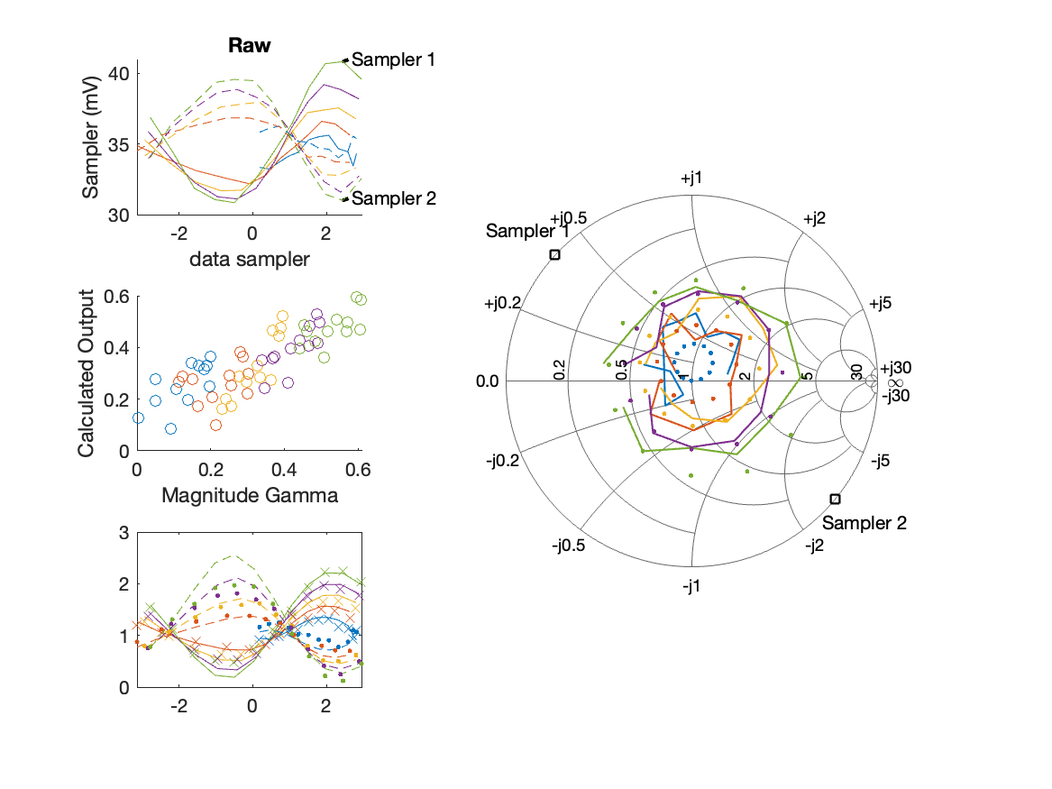
Sampler Performance Frequency 10.50 GHz, Power 12 dBm
Sampler Av
Sampler 1: 88.632
Sampler 2: 107.788
Sampler Offset (rather than -1)
-6.778
Goodness Of fit
0.19389

Slide 4
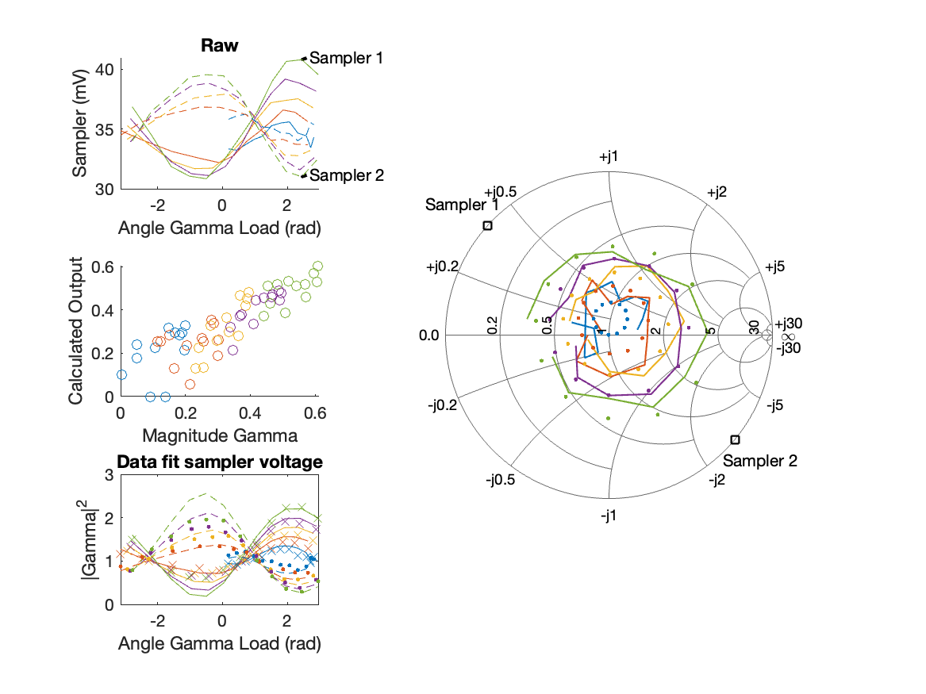
Sampler Performance x^3 Frequency 10.50 GHz, Power 12 dBm
Sampler Av
Sampler 1: 3.414366e-03
Sampler 2: 0.000
Sampler Av3
Sampler 1: 27.682
Sampler 2: 29.605
Sampler Offset (rather than -1)
-1.9474
Goodness Of fit
0.12939

Slide 5
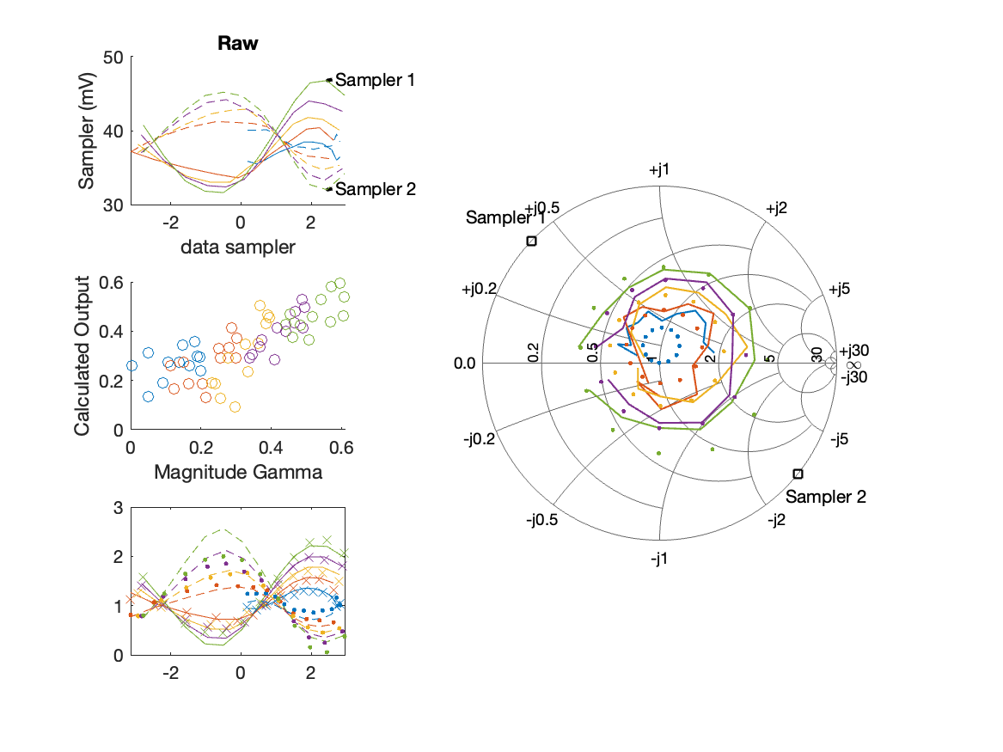
Sampler Performance Frequency 10.50 GHz, Power 14 dBm
Sampler Av
Sampler 1: 61.948
Sampler 2: 73.737
Sampler Offset (rather than -1)
-5.077
Goodness Of fit
0.20302

Slide 6
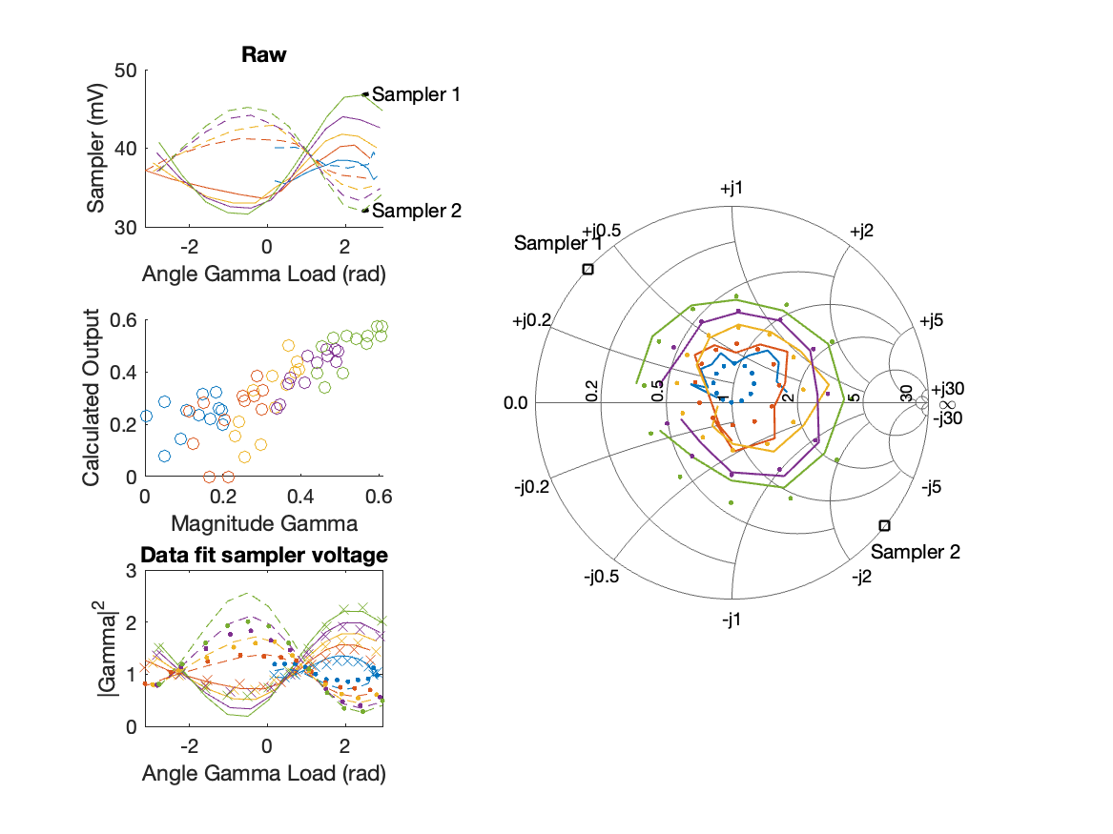
Sampler Performance x^3 Frequency 10.50 GHz, Power 14 dBm
Sampler Av
Sampler 1: 2.231546e+01
Sampler 2: 0.000
Sampler Av3
Sampler 1: 19.365
Sampler 2: 24.369
Sampler Offset (rather than -1)
-1.9831
Goodness Of fit
0.12776

Slide 7
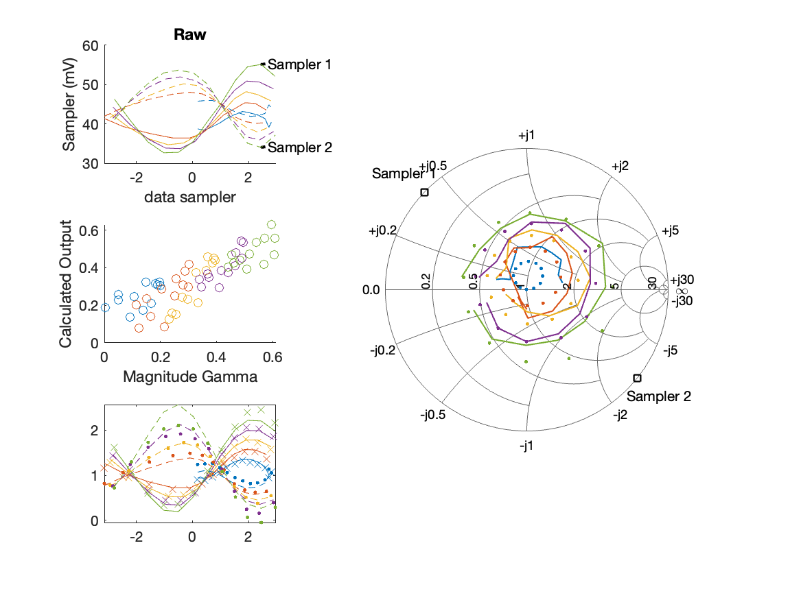
Sampler Performance Frequency 10.50 GHz, Power 16 dBm
Sampler Av
Sampler 1: 46.867
Sampler 2: 54.663
Sampler Offset (rather than -1)
-4.2506
Goodness Of fit
0.16309

Slide 8

Sampler Performance x^3 Frequency 10.50 GHz, Power 16 dBm
Sampler Av
Sampler 1: 3.481698e+01
Sampler 2: 0.000
Sampler Av3
Sampler 1: 10.400
Sampler 2: 20.158
Sampler Offset (rather than -1)
-2.1478
Goodness Of fit
0.086137

Slide 9
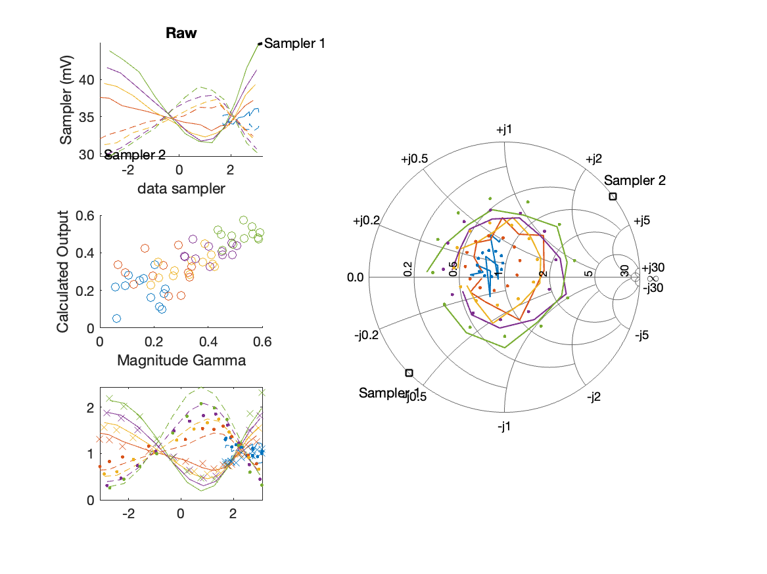
Sampler Performance Frequency 10.60 GHz, Power 12 dBm
Sampler Av
Sampler 1: 70.790
Sampler 2: 97.580
Sampler Offset (rather than -1)
-5.7629
Goodness Of fit
0.21427

Slide 10
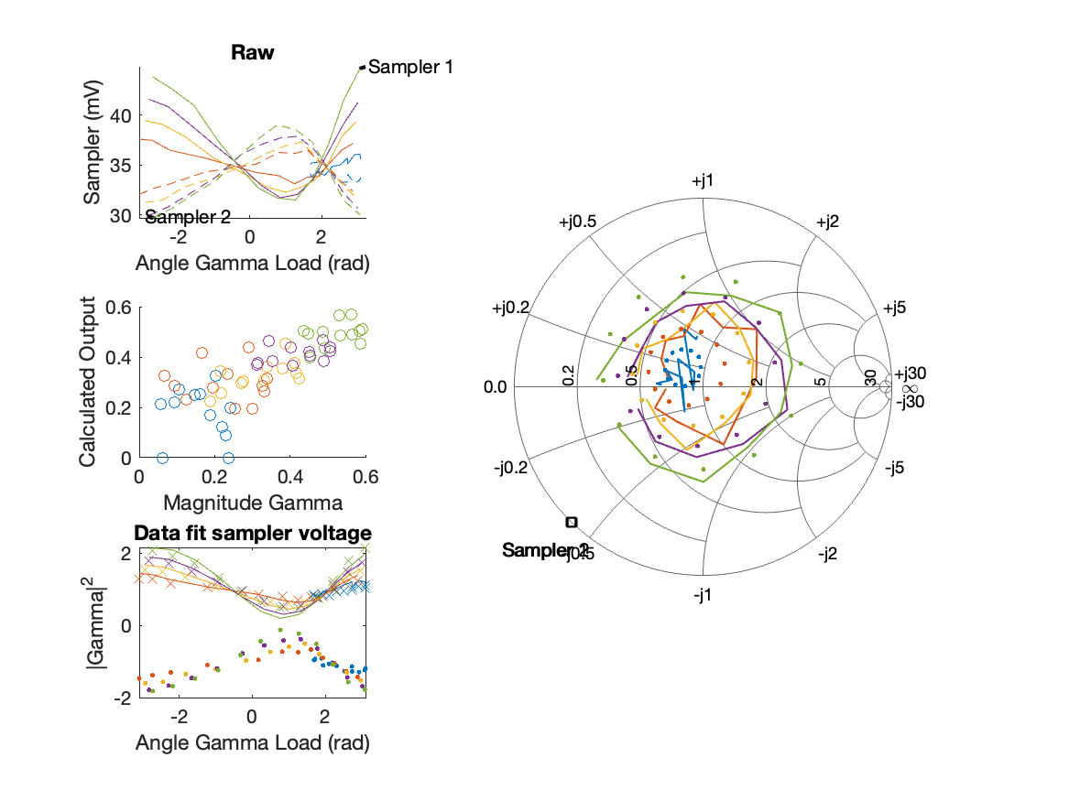
Sampler Performance x^3 Frequency 10.60 GHz, Power 12 dBm
Sampler Av
Sampler 1: 8.022496e+01
Sampler 2: 0.008
Sampler Av3
Sampler 1: -15.596
Sampler 2: 29.447
Sampler Offset (rather than -1)
-3.6187
Goodness Of fit
0.19899

Slide 11
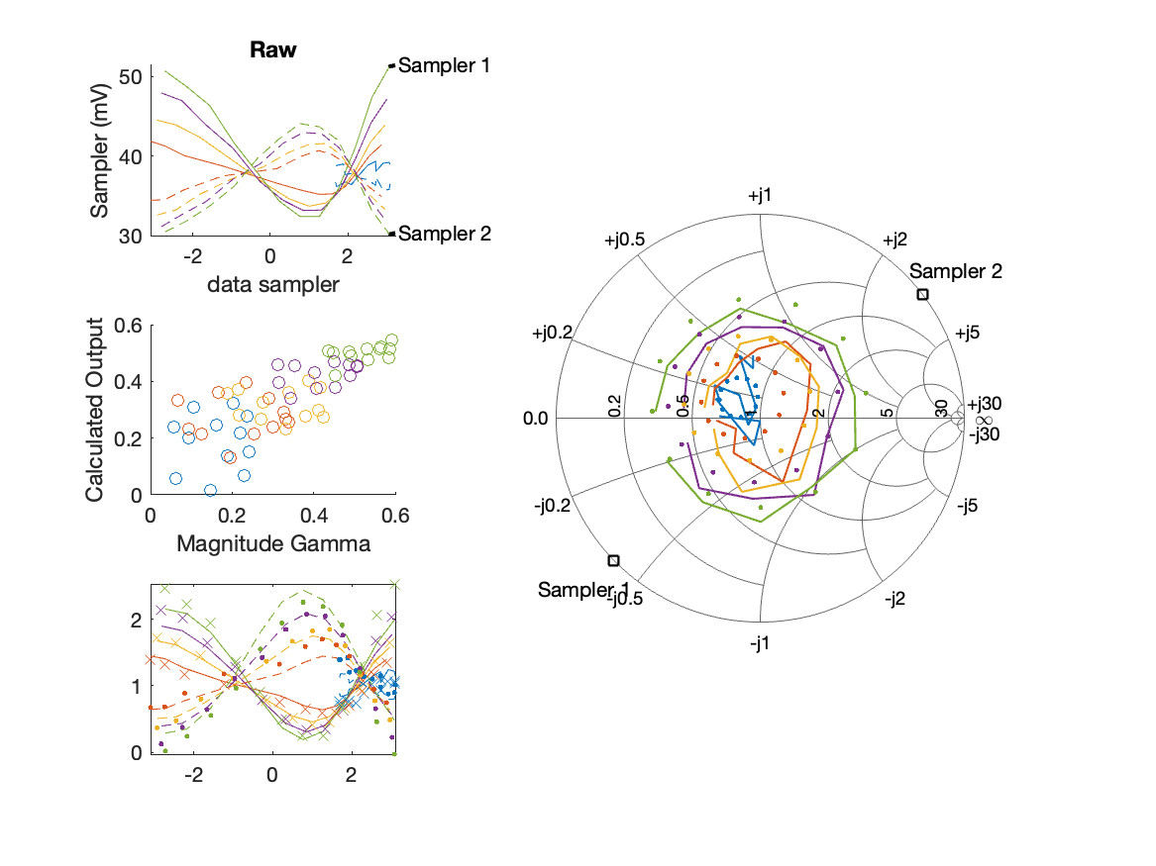
Sampler Performance Frequency 10.60 GHz, Power 14 dBm
Sampler Av
Sampler 1: 60.384
Sampler 2: 81.920
Sampler Offset (rather than -1)
-5.3024
Goodness Of fit
0.18772

Slide 12
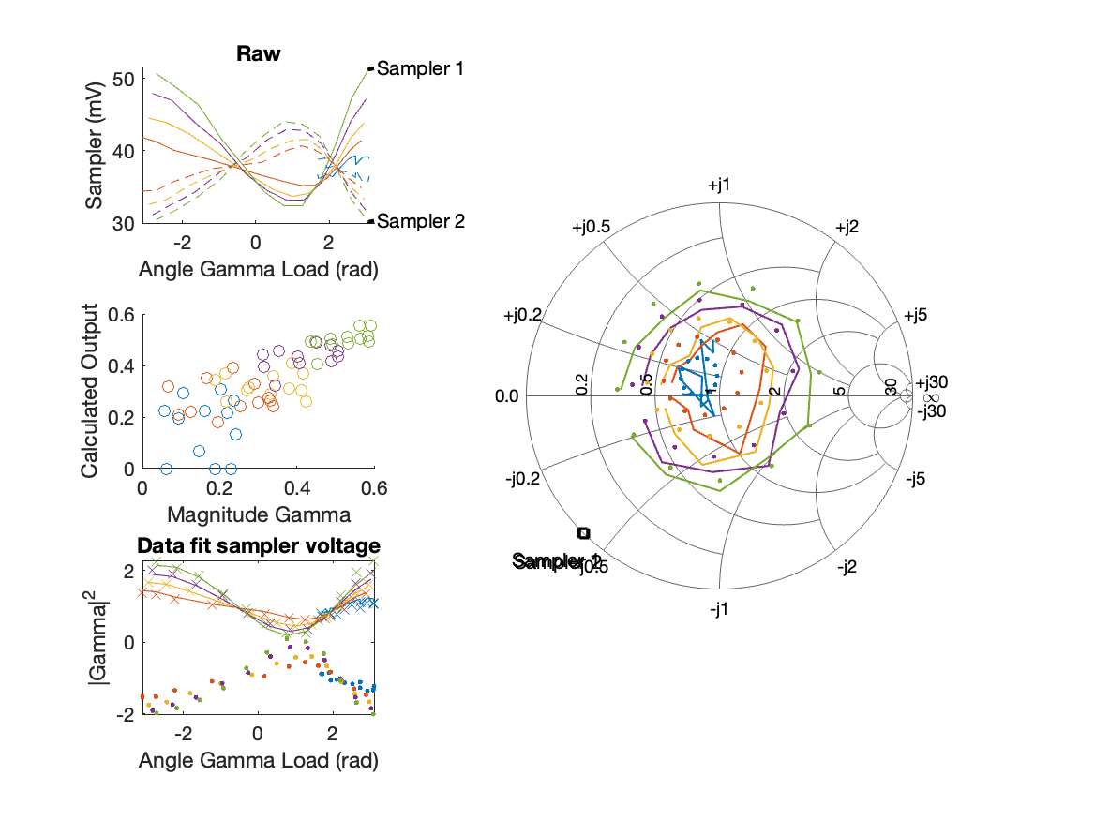
Sampler Performance x^3 Frequency 10.60 GHz, Power 14 dBm
Sampler Av
Sampler 1: 8.084399e+01
Sampler 2: 0.000
Sampler Av3
Sampler 1: -17.266
Sampler 2: 26.230
Sampler Offset (rather than -1)
-3.6847
Goodness Of fit
0.16364

Slide 13
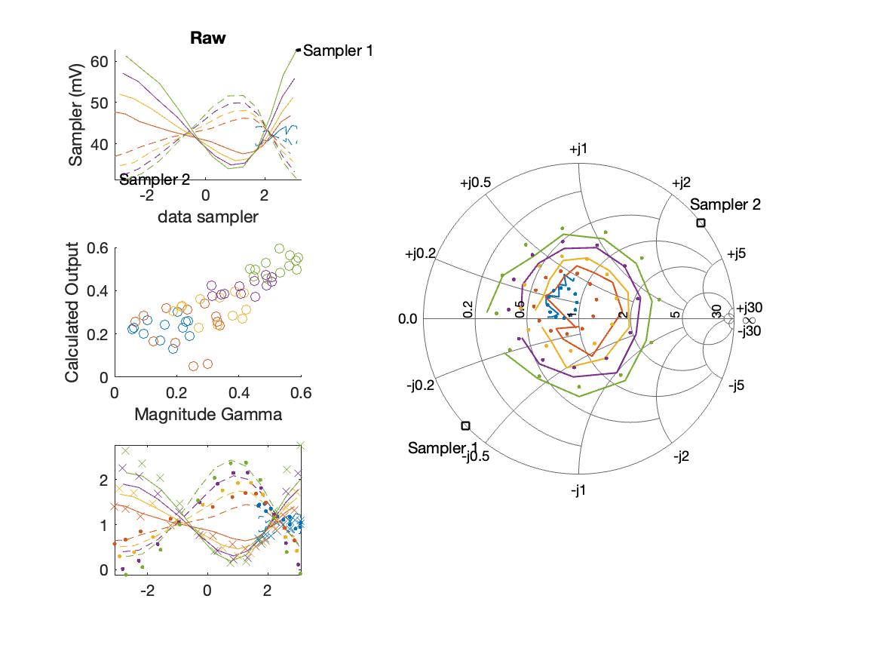
Sampler Performance Frequency 10.60 GHz, Power 16 dBm
Sampler Av
Sampler 1: 45.865
Sampler 2: 61.167
Sampler Offset (rather than -1)
-4.4515
Goodness Of fit
0.14608

Slide 14
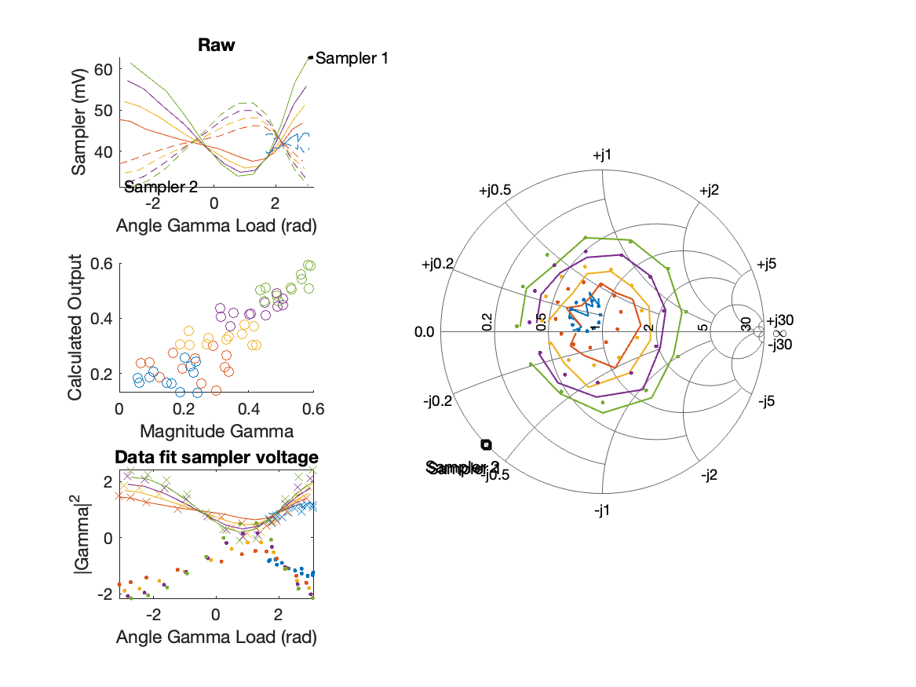
Sampler Performance x^3 Frequency 10.60 GHz, Power 16 dBm
Sampler Av
Sampler 1: 9.055579e+01
Sampler 2: 0.000
Sampler Av3
Sampler 1: -18.599
Sampler 2: 23.173
Sampler Offset (rather than -1)
-4.2227
Goodness Of fit
0.10031

Slide 15
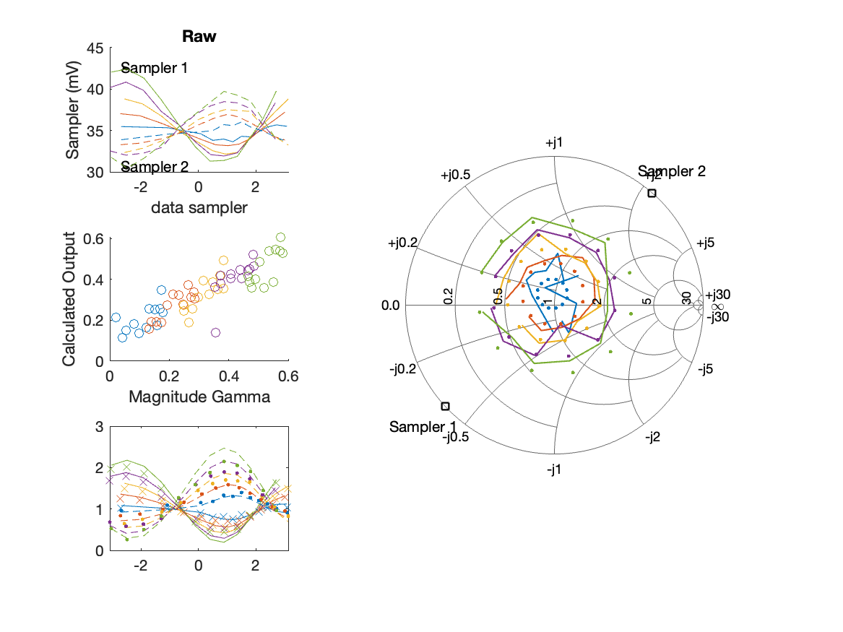
Sampler Performance Frequency 10.70 GHz, Power 12 dBm
Sampler Av
Sampler 1: 70.540
Sampler 2: 101.651
Sampler Offset (rather than -1)
-5.9598
Goodness Of fit
0.14148

Slide 16
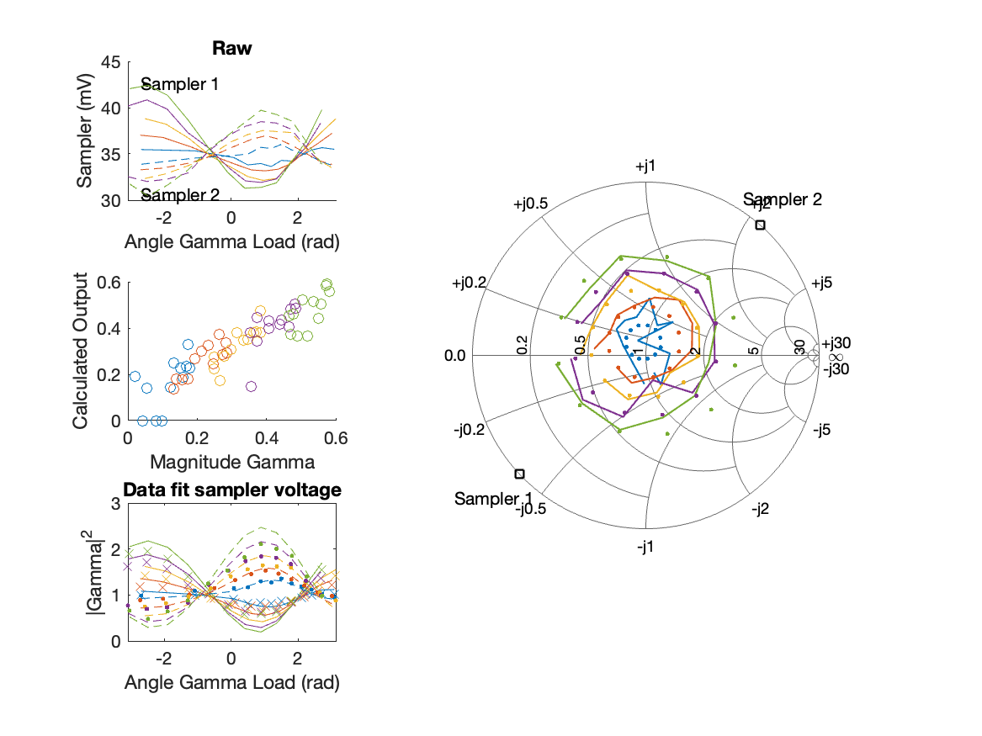
Sampler Performance x^3 Frequency 10.70 GHz, Power 12 dBm
Sampler Av
Sampler 1: 1.983447e+00
Sampler 2: 0.012
Sampler Av3
Sampler 1: 24.421
Sampler 2: 28.694
Sampler Offset (rather than -1)
-1.6519
Goodness Of fit
0.10975

Slide 17
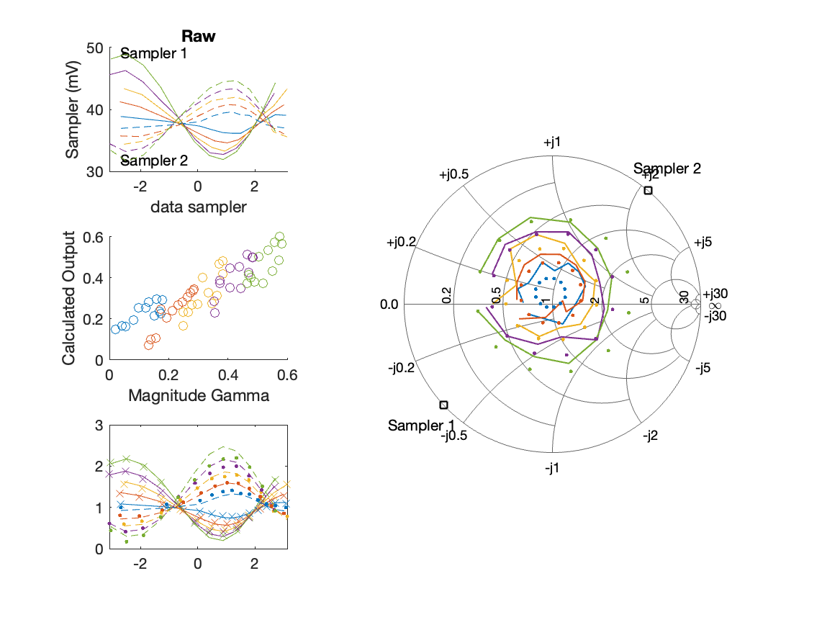
Sampler Performance Frequency 10.70 GHz, Power 14 dBm
Sampler Av
Sampler 1: 54.327
Sampler 2: 78.025
Sampler Offset (rather than -1)
-4.9666
Goodness Of fit
0.1328

Slide 18
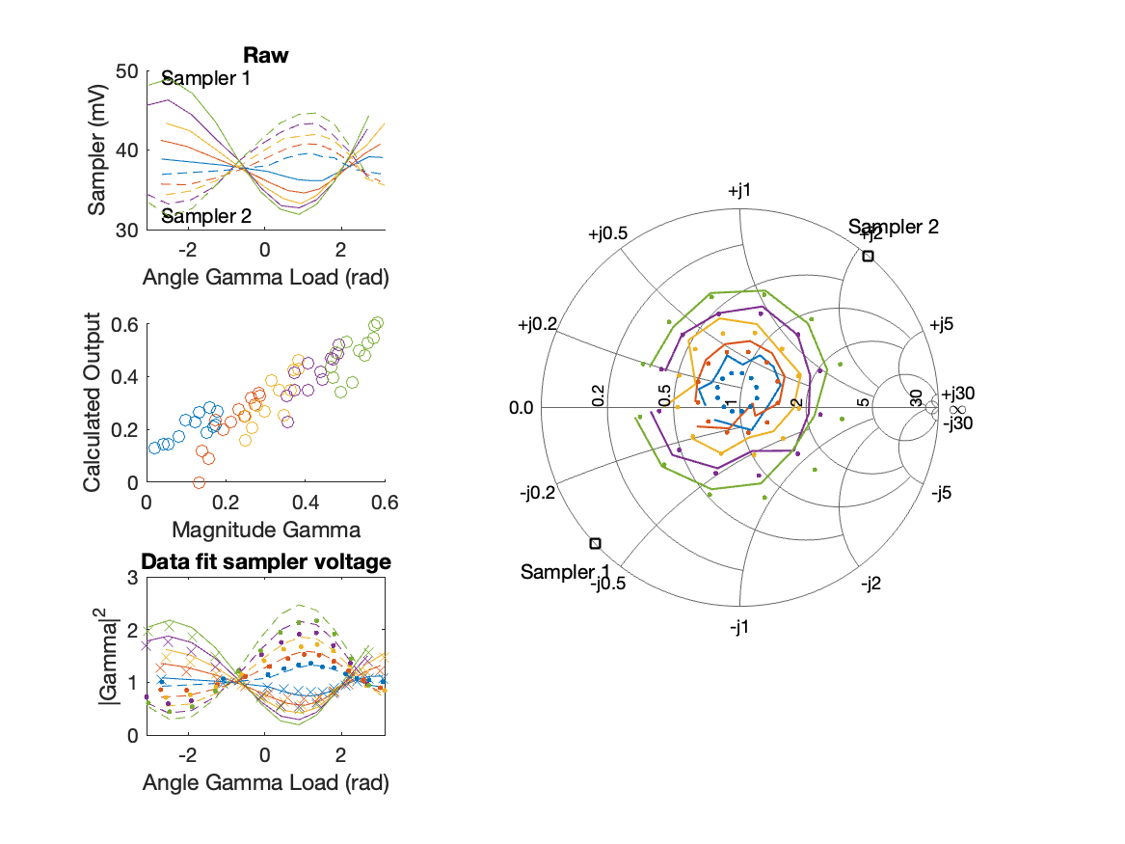
Sampler Performance x^3 Frequency 10.70 GHz, Power 14 dBm
Sampler Av
Sampler 1: 2.504440e+01
Sampler 2: 0.048
Sampler Av3
Sampler 1: 16.221
Sampler 2: 24.648
Sampler Offset (rather than -1)
-1.96
Goodness Of fit
0.095204

Slide 19

Sampler Performance Frequency 10.70 GHz, Power 16 dBm
Sampler Av
Sampler 1: 39.209
Sampler 2: 54.305
Sampler Offset (rather than -1)
-3.9002
Goodness Of fit
0.13744

Slide 20

Sampler Performance x^3 Frequency 10.70 GHz, Power 16 dBm
Sampler Av
Sampler 1: 2.441044e+01
Sampler 2: 1.422
Sampler Av3
Sampler 1: 10.960
Sampler 2: 19.915
Sampler Offset (rather than -1)
-1.7501
Goodness Of fit
0.085601

Slide 21
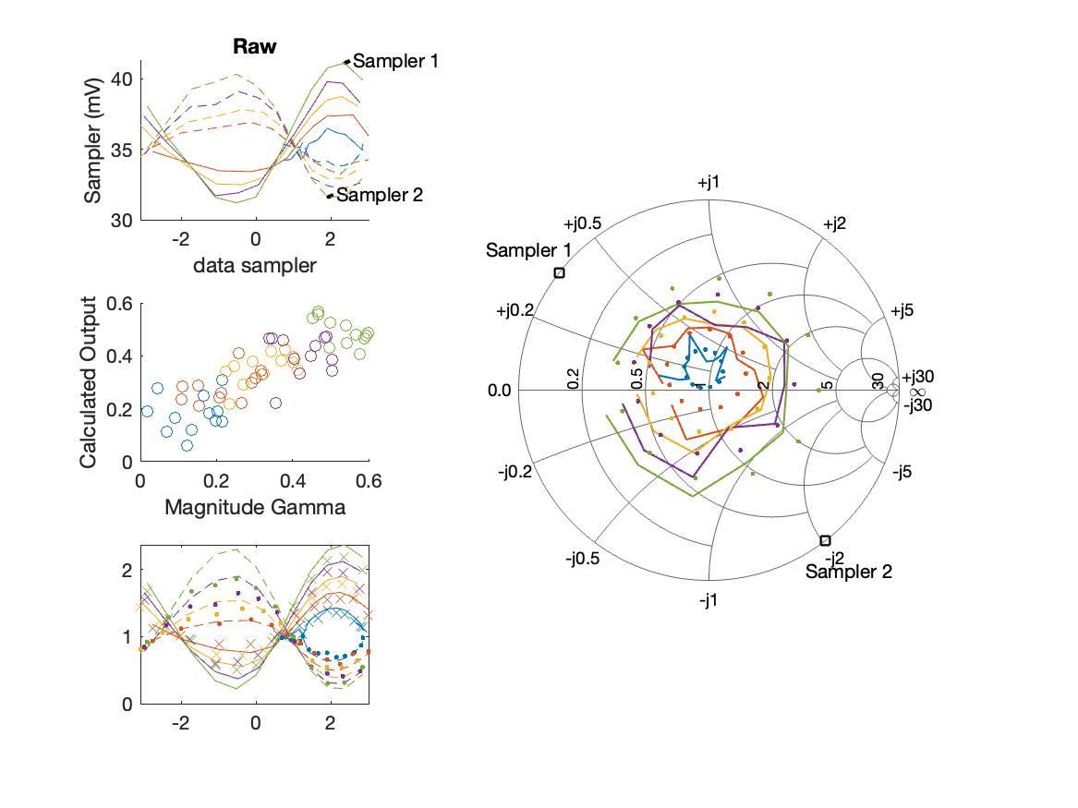
Sampler Performance Frequency 10.80 GHz, Power 12 dBm
Sampler Av
Sampler 1: 84.790
Sampler 2: 89.580
Sampler Offset (rather than -1)
-6.0556
Goodness Of fit
0.24428

Slide 22
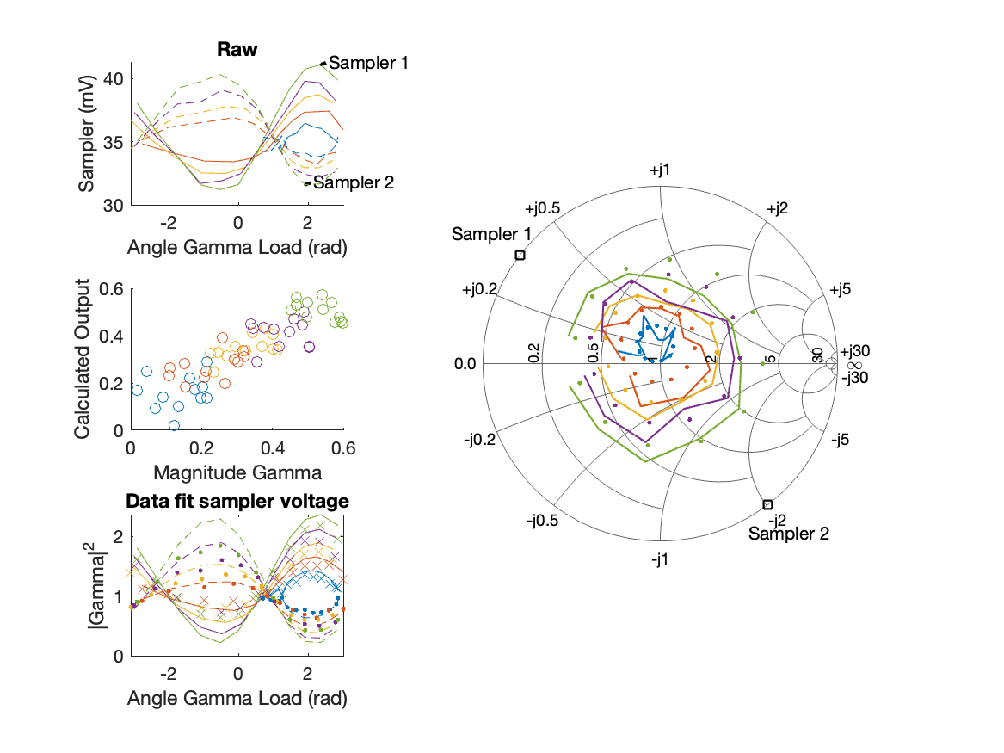
Sampler Performance x^3 Frequency 10.80 GHz, Power 12 dBm
Sampler Av
Sampler 1: 2.151851e-07
Sampler 2: 0.000
Sampler Av3
Sampler 1: 27.009
Sampler 2: 27.515
Sampler Offset (rather than -1)
-1.7013
Goodness Of fit
0.19052

Slide 23
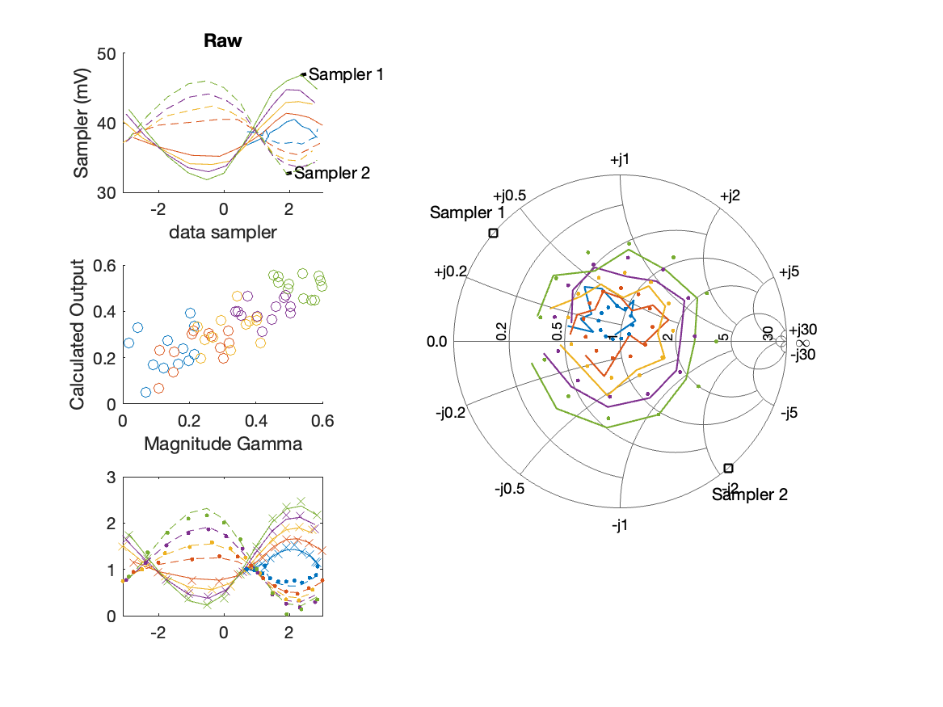
Sampler Performance Frequency 10.80 GHz, Power 14 dBm
Sampler Av
Sampler 1: 74.498
Sampler 2: 79.602
Sampler Offset (rather than -1)
-5.8266
Goodness Of fit
0.19862

Slide 24
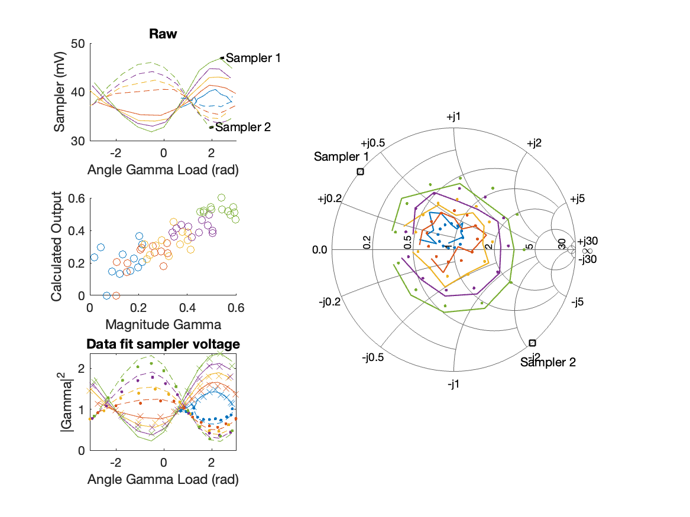
Sampler Performance x^3 Frequency 10.80 GHz, Power 14 dBm
Sampler Av
Sampler 1: 4.274969e+01
Sampler 2: 0.000
Sampler Av3
Sampler 1: 16.620
Sampler 2: 24.482
Sampler Offset (rather than -1)
-2.6589
Goodness Of fit
0.15141

Slide 25
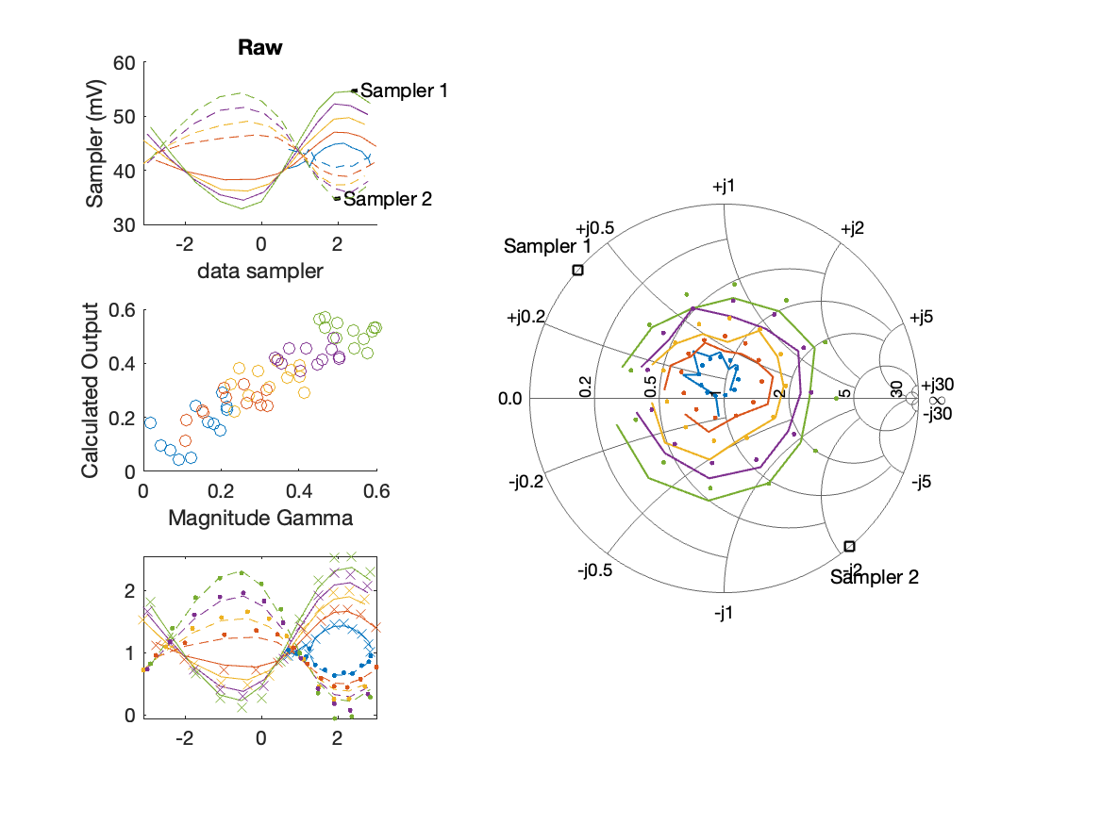
Sampler Performance Frequency 10.80 GHz, Power 16 dBm
Sampler Av
Sampler 1: 55.894
Sampler 2: 59.512
Sampler Offset (rather than -1)
-4.8631
Goodness Of fit
0.15217

Slide 26

Sampler Performance x^3 Frequency 10.80 GHz, Power 16 dBm
Sampler Av
Sampler 1: 4.785357e+01
Sampler 2: 5.388
Sampler Av3
Sampler 1: -1.329
Sampler 2: 19.732
Sampler Offset (rather than -1)
-2.8177
Goodness Of fit
0.11713

Slide 27
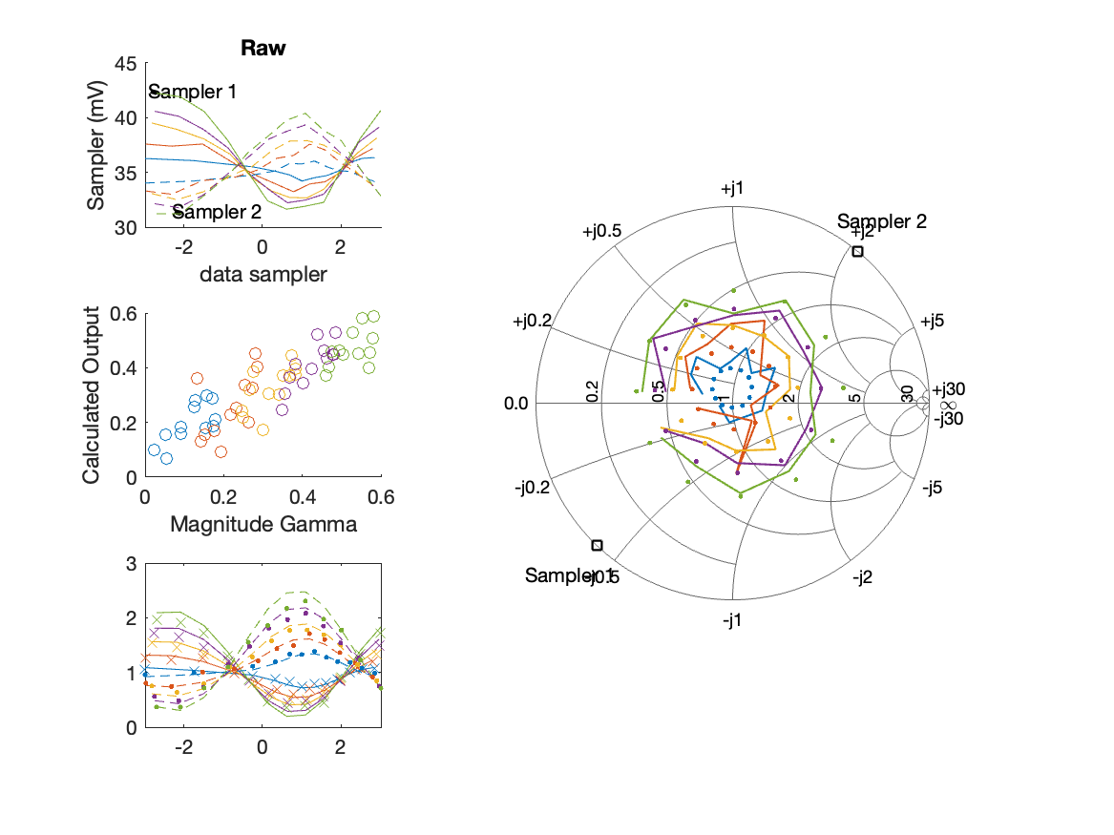
Sampler Performance Frequency 10.90 GHz, Power 12 dBm
Sampler Av
Sampler 1: 76.099
Sampler 2: 105.621
Sampler Offset (rather than -1)
-6.3493
Goodness Of fit
0.15861

Slide 28

Sampler Performance x^3 Frequency 10.90 GHz, Power 12 dBm
Sampler Av
Sampler 1: 9.962846e-05
Sampler 2: 5.787
Sampler Av3
Sampler 1: 25.289
Sampler 2: 28.300
Sampler Offset (rather than -1)
-1.8593
Goodness Of fit
0.11975

Slide 29
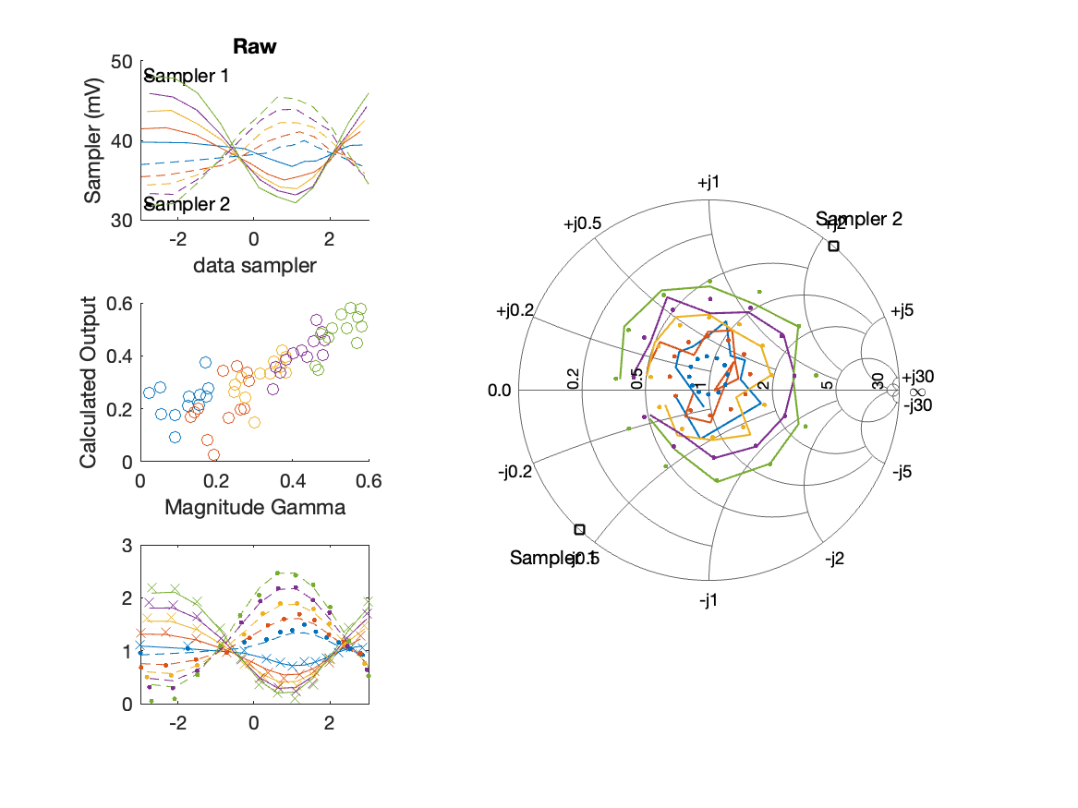
Sampler Performance Frequency 10.90 GHz, Power 14 dBm
Sampler Av
Sampler 1: 65.880
Sampler 2: 88.510
Sampler Offset (rather than -1)
-5.8585
Goodness Of fit
0.11888

Slide 30
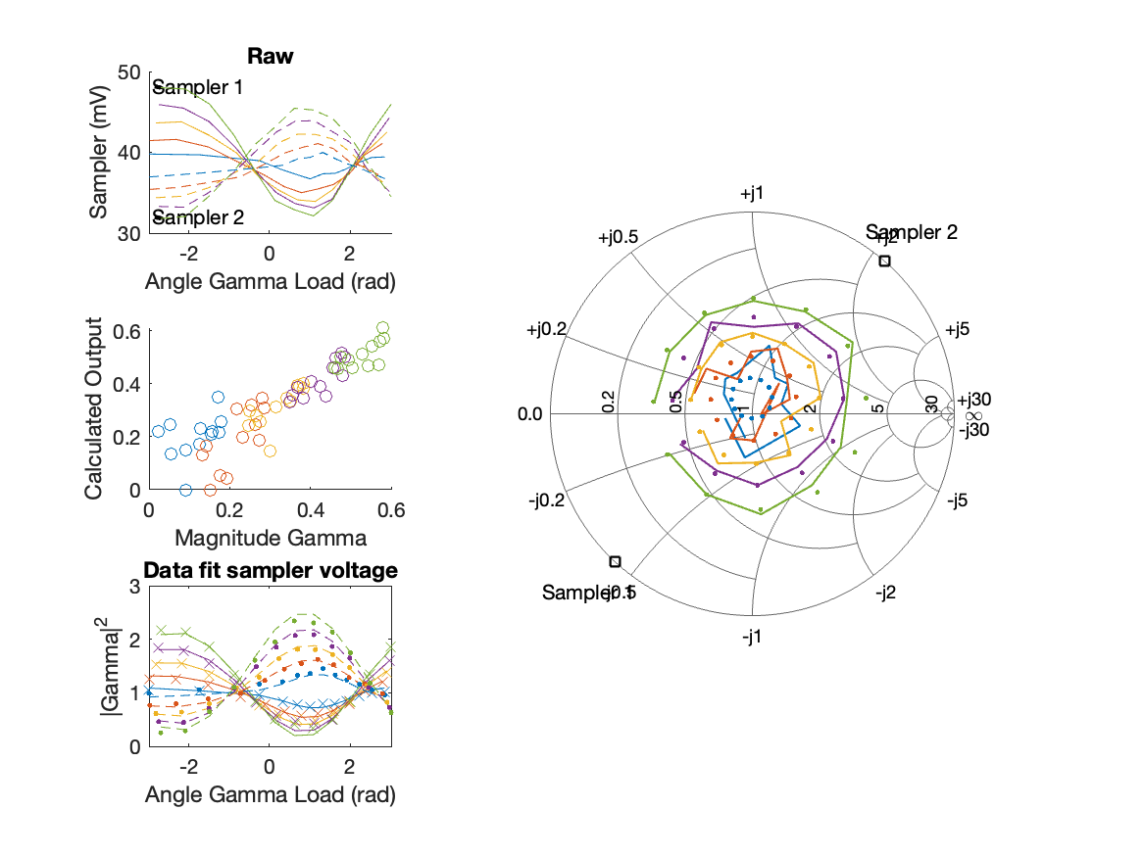
Sampler Performance x^3 Frequency 10.90 GHz, Power 14 dBm
Sampler Av
Sampler 1: 1.045043e+00
Sampler 2: 54.131
Sampler Av3
Sampler 1: 22.596
Sampler 2: 17.065
Sampler Offset (rather than -1)
-2.9999
Goodness Of fit
0.07079

Slide 31
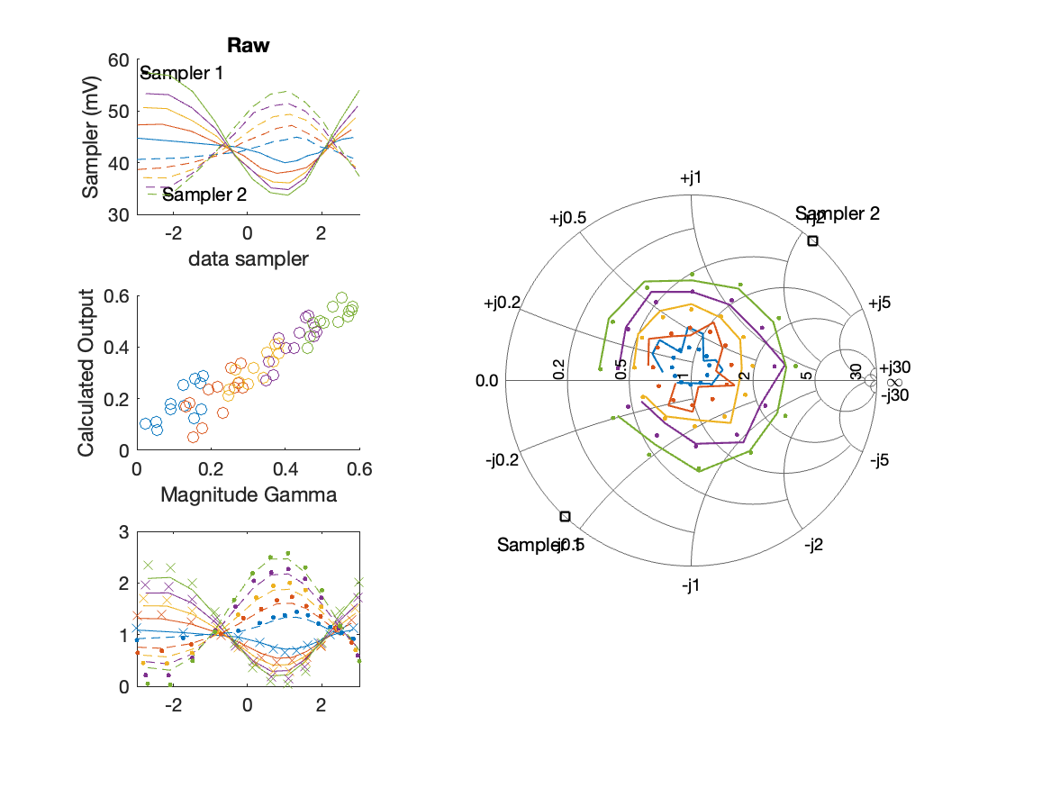
Sampler Performance Frequency 10.90 GHz, Power 16 dBm
Sampler Av
Sampler 1: 48.453
Sampler 2: 63.379
Sampler Offset (rather than -1)
-4.7377
Goodness Of fit
0.053756

Slide 32
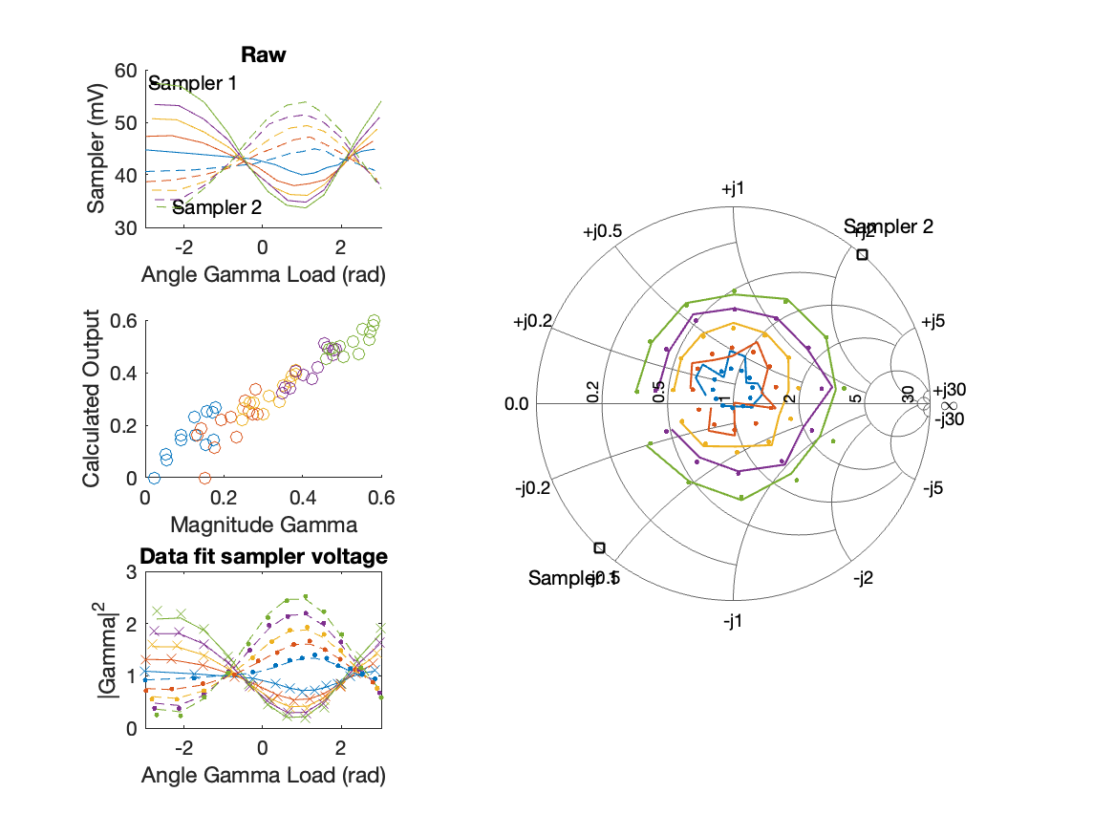
Sampler Performance x^3 Frequency 10.90 GHz, Power 16 dBm
Sampler Av
Sampler 1: 3.362269e+01
Sampler 2: 33.267
Sampler Av3
Sampler 1: 11.387
Sampler 2: 15.916
Sampler Offset (rather than -1)
-3.2549
Goodness Of fit
0.032122

Slide 33
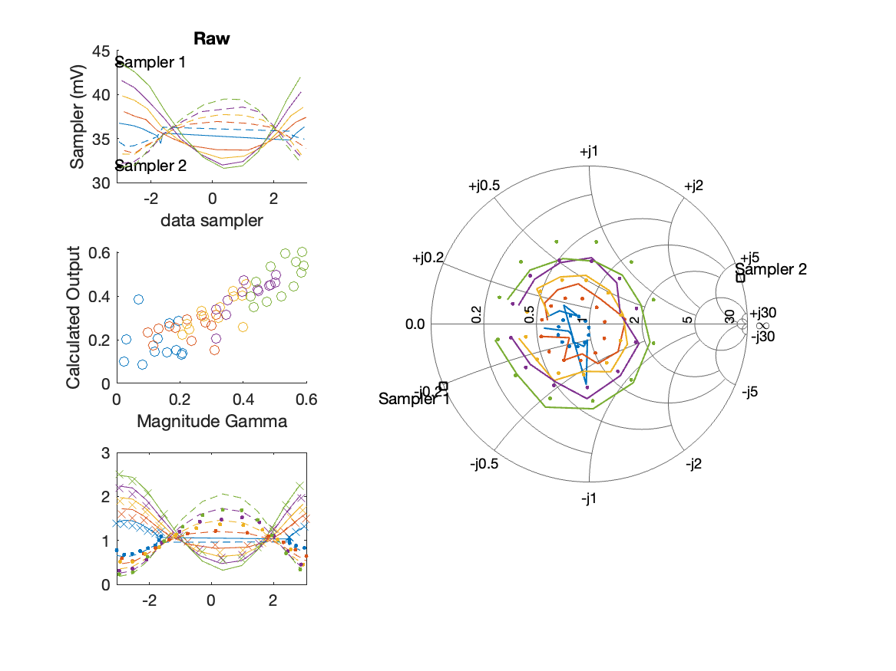
Sampler Performance Frequency 11.00 GHz, Power 12 dBm
Sampler Av
Sampler 1: 81.940
Sampler 2: 94.461
Sampler Offset (rather than -1)
-6.199
Goodness Of fit
0.12969

Slide 34
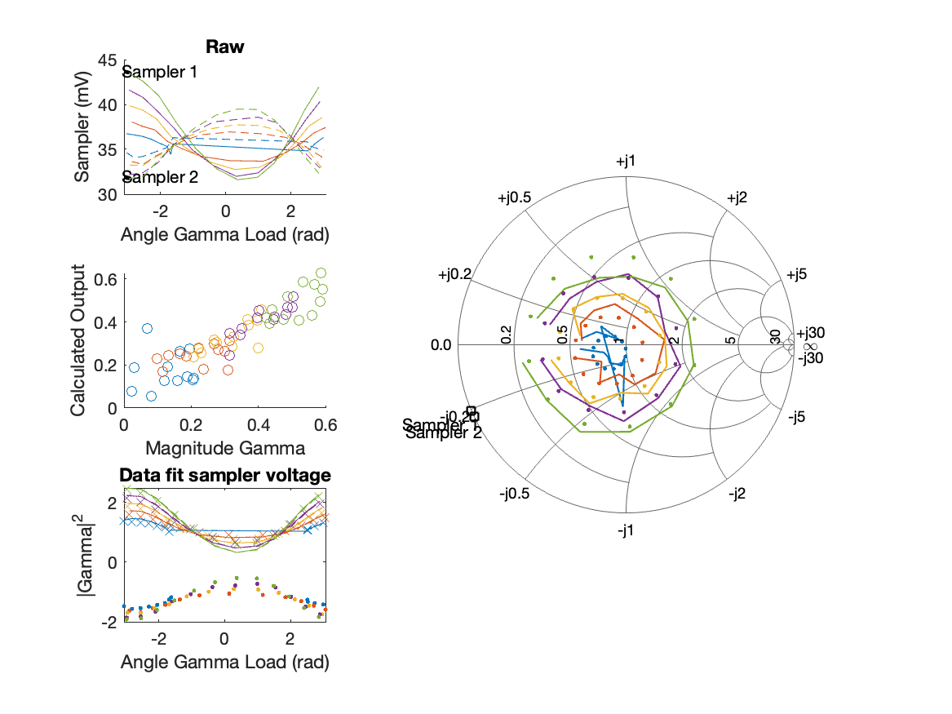
Sampler Performance x^3 Frequency 11.00 GHz, Power 12 dBm
Sampler Av
Sampler 1: 6.683596e+01
Sampler 2: 0.000
Sampler Av3
Sampler 1: 13.779
Sampler 2: 28.592
Sampler Offset (rather than -1)
-3.4798
Goodness Of fit
0.10798

Slide 35
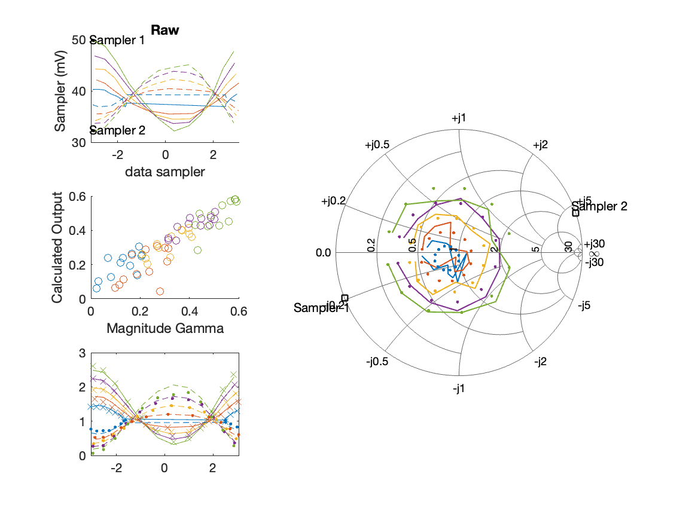
Sampler Performance Frequency 11.00 GHz, Power 14 dBm
Sampler Av
Sampler 1: 63.361
Sampler 2: 68.654
Sampler Offset (rather than -1)
-5.0207
Goodness Of fit
0.083161

Slide 36
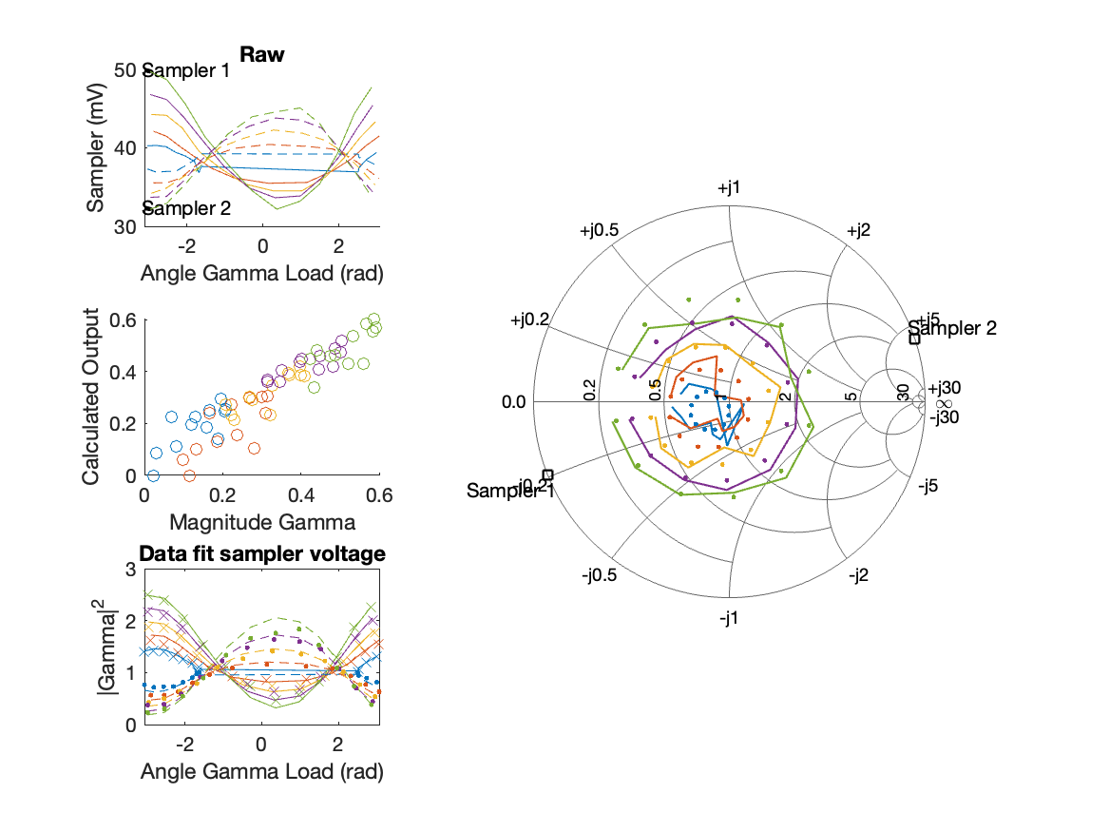
Sampler Performance x^3 Frequency 11.00 GHz, Power 14 dBm
Sampler Av
Sampler 1: 5.865520e+01
Sampler 2: 10.577
Sampler Av3
Sampler 1: -4.914
Sampler 2: 22.522
Sampler Offset (rather than -1)
-3.2557
Goodness Of fit
0.070859

Slide 37
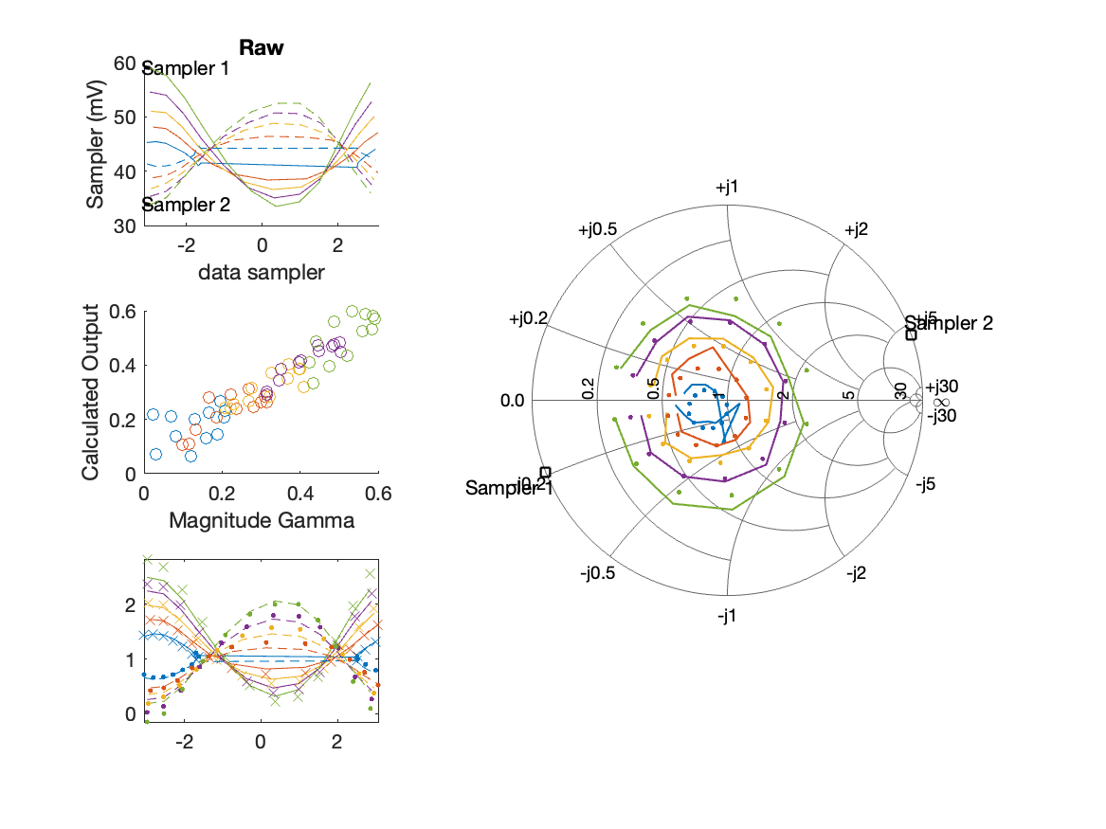
Sampler Performance Frequency 11.00 GHz, Power 16 dBm
Sampler Av
Sampler 1: 50.953
Sampler 2: 57.396
Sampler Offset (rather than -1)
-4.6081
Goodness Of fit
0.064064

Slide 38
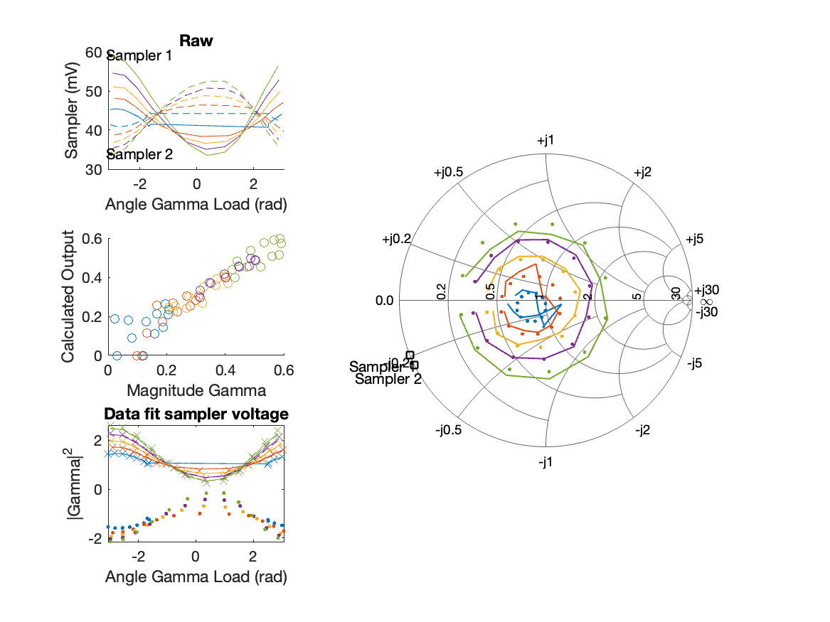
Sampler Performance x^3 Frequency 11.00 GHz, Power 16 dBm
Sampler Av
Sampler 1: 6.264890e+01
Sampler 2: 0.000
Sampler Av3
Sampler 1: -13.392
Sampler 2: 21.097
Sampler Offset (rather than -1)
-3.2083
Goodness Of fit
0.036699

Slide 39
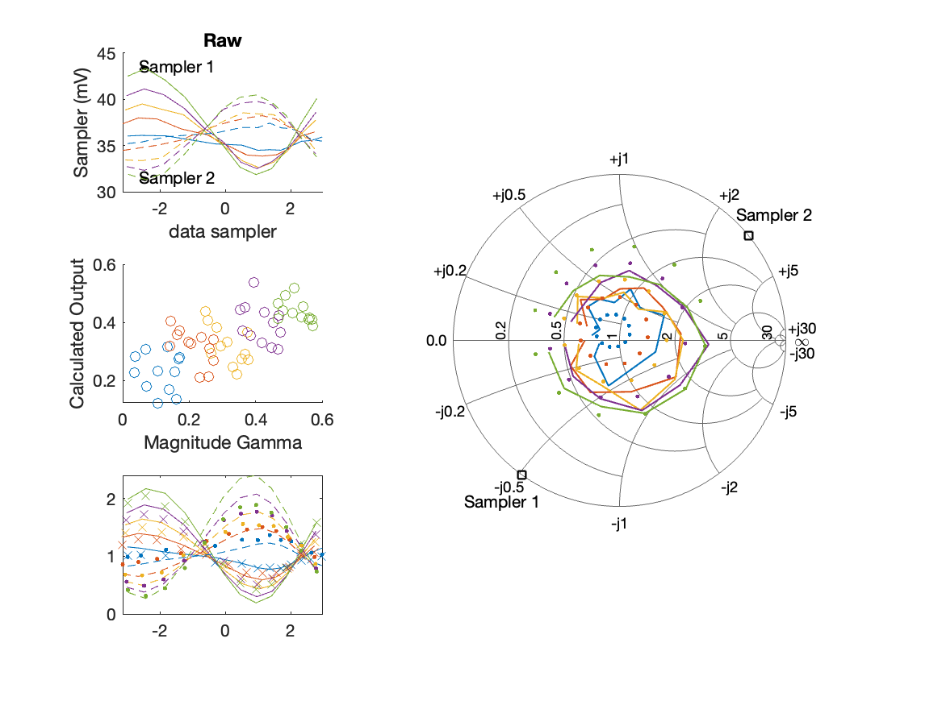
Sampler Performance Frequency 11.10 GHz, Power 12 dBm
Sampler Av
Sampler 1: 70.430
Sampler 2: 85.873
Sampler Offset (rather than -1)
-5.5476
Goodness Of fit
0.3465

Slide 40
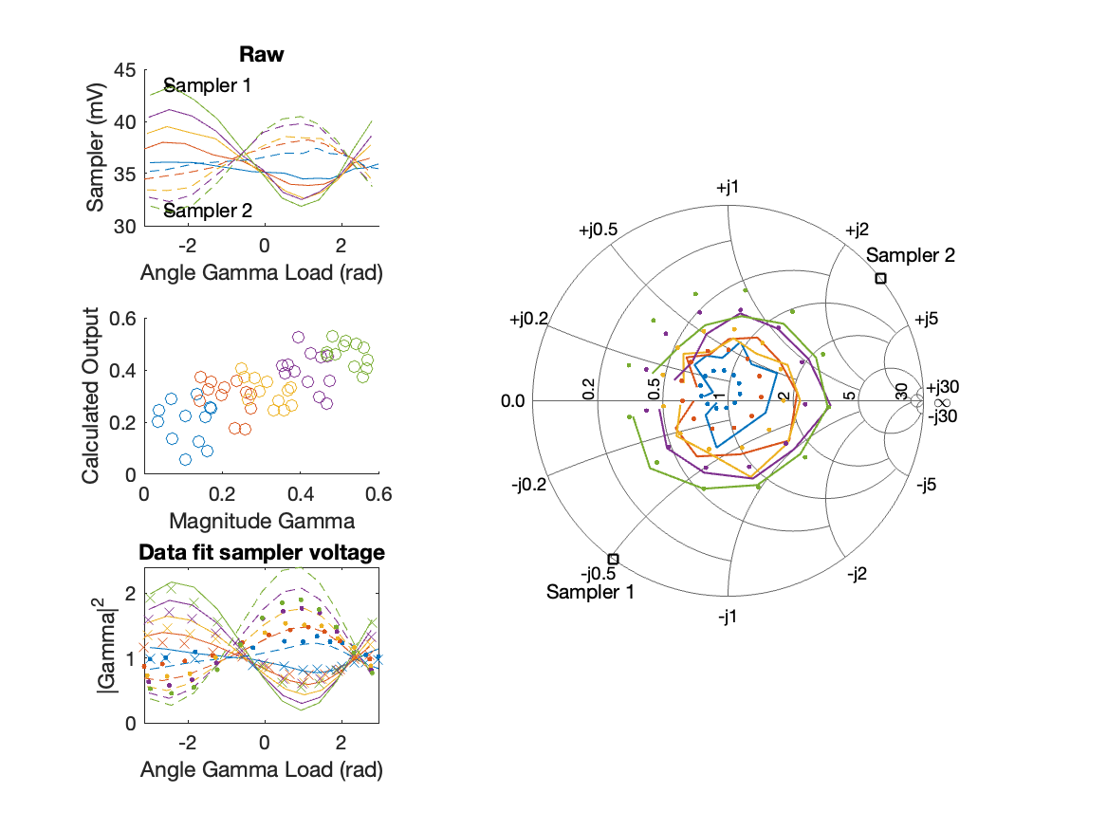
Sampler Performance x^3 Frequency 11.10 GHz, Power 12 dBm
Sampler Av
Sampler 1: 4.145468e-10
Sampler 2: 0.000
Sampler Av3
Sampler 1: 24.958
Sampler 2: 27.268
Sampler Offset (rather than -1)
-1.61
Goodness Of fit
0.27506

Slide 41
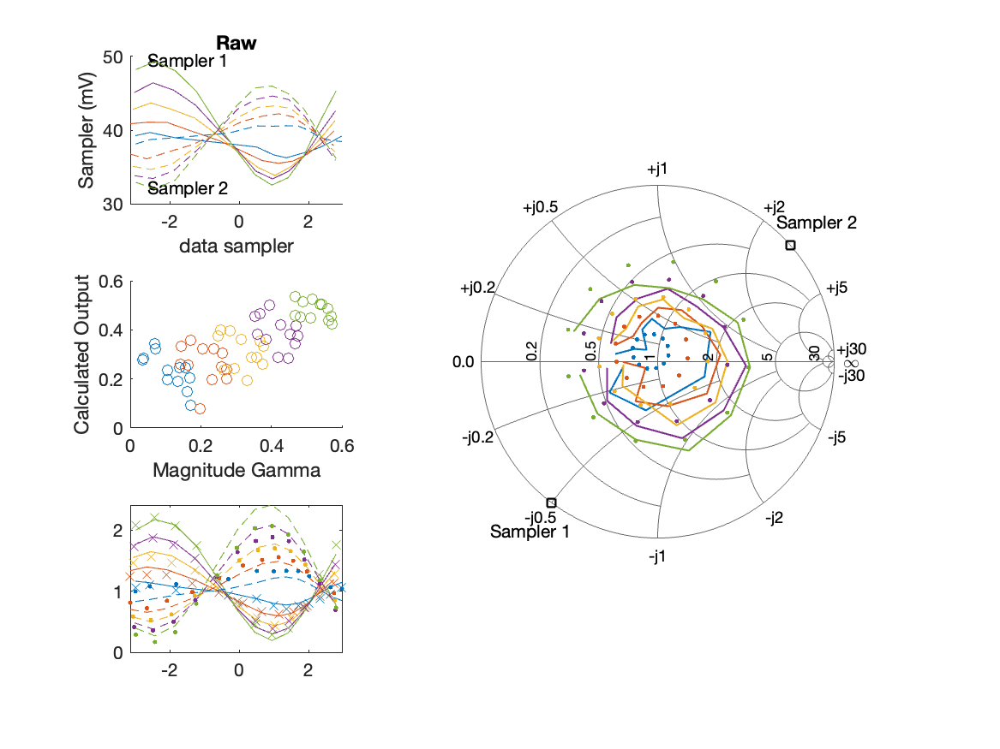
Sampler Performance Frequency 11.10 GHz, Power 14 dBm
Sampler Av
Sampler 1: 57.313
Sampler 2: 68.080
Sampler Offset (rather than -1)
-4.8044
Goodness Of fit
0.25012

Slide 42
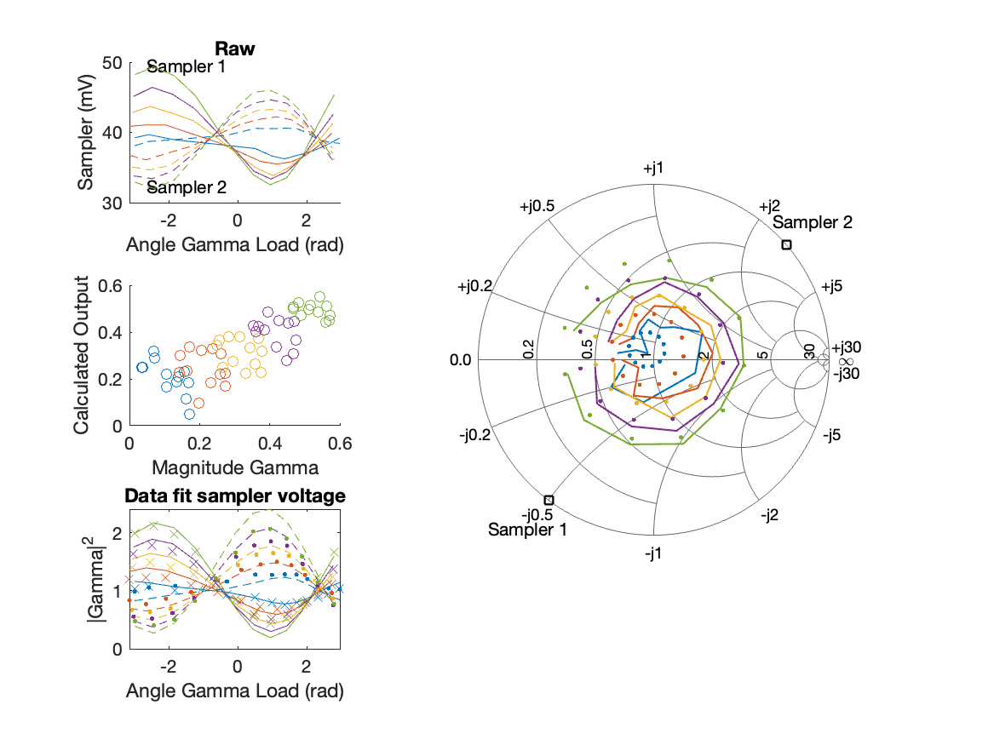
Sampler Performance x^3 Frequency 11.10 GHz, Power 14 dBm
Sampler Av
Sampler 1: 3.099798e+01
Sampler 2: 0.000
Sampler Av3
Sampler 1: 15.593
Sampler 2: 23.461
Sampler Offset (rather than -1)
-2.1328
Goodness Of fit
0.19144

Slide 43
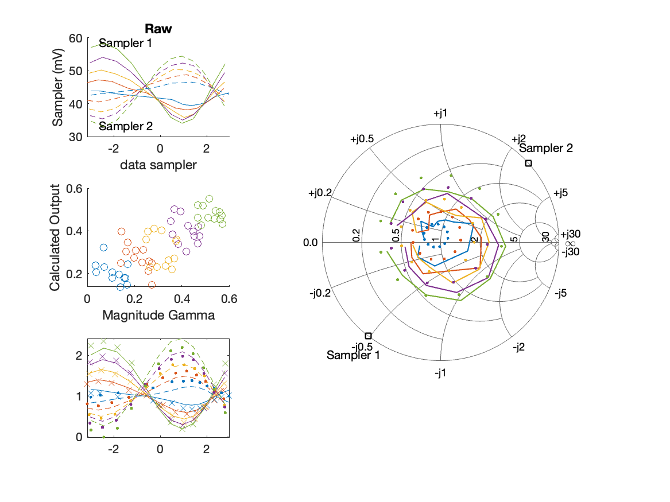
Sampler Performance Frequency 11.10 GHz, Power 16 dBm
Sampler Av
Sampler 1: 44.355
Sampler 2: 51.424
Sampler Offset (rather than -1)
-4.1039
Goodness Of fit
0.23208

Slide 44
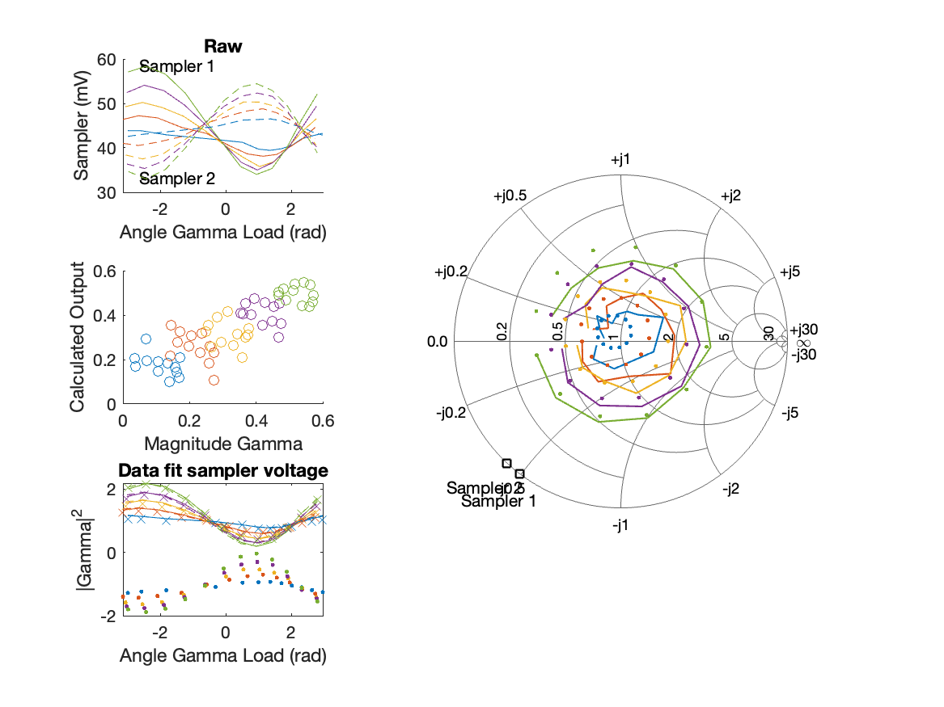
Sampler Performance x^3 Frequency 11.10 GHz, Power 16 dBm
Sampler Av
Sampler 1: 3.304731e+01
Sampler 2: 0.000
Sampler Av3
Sampler 1: 8.522
Sampler 2: 19.461
Sampler Offset (rather than -1)
-2.0497
Goodness Of fit
0.16862

Slide 45
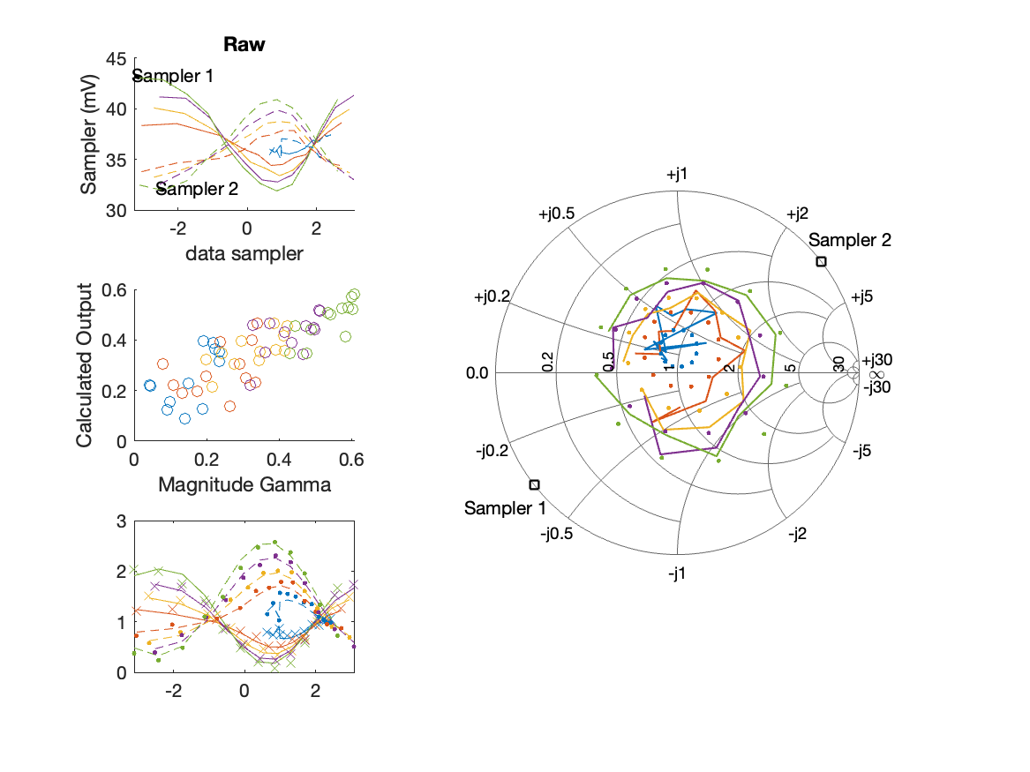
Sampler Performance Frequency 11.20 GHz, Power 12 dBm
Sampler Av
Sampler 1: 87.761
Sampler 2: 130.322
Sampler Offset (rather than -1)
-7.8038
Goodness Of fit
0.21235

Slide 46
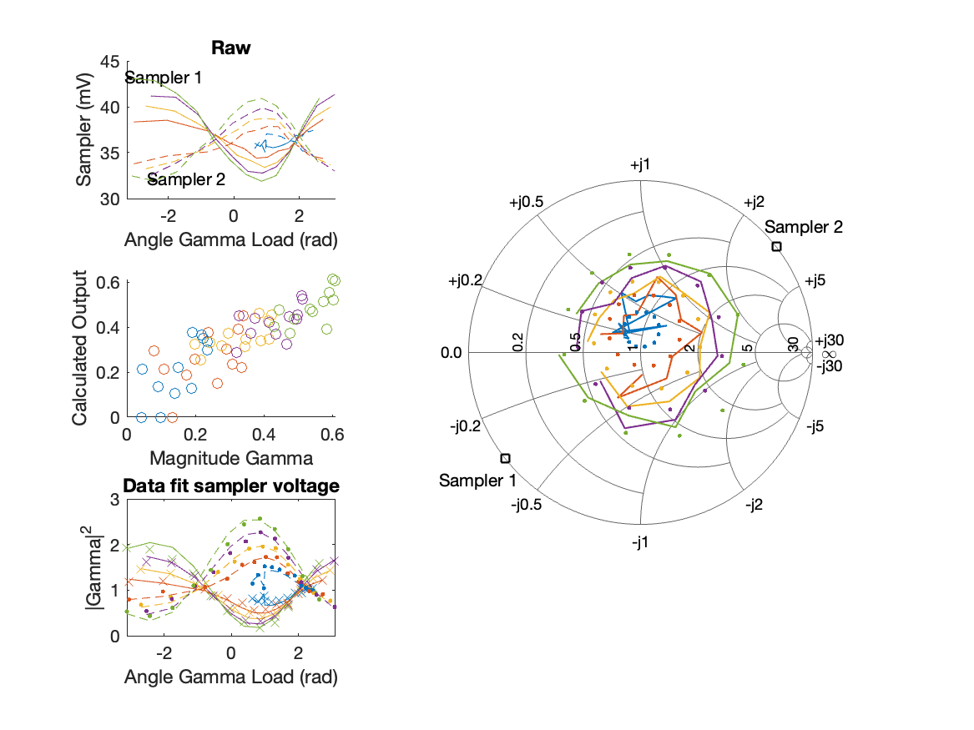
Sampler Performance x^3 Frequency 11.20 GHz, Power 12 dBm
Sampler Av
Sampler 1: 7.127099e+01
Sampler 2: 1.706
Sampler Av3
Sampler 1: 11.519
Sampler 2: 30.822
Sampler Offset (rather than -1)
-4.0222
Goodness Of fit
0.19267

Slide 47
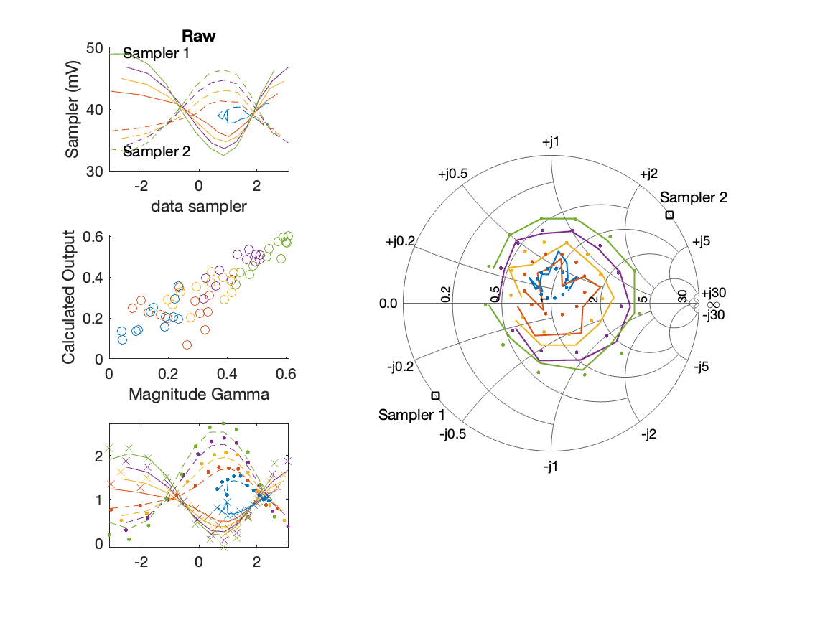
Sampler Performance Frequency 11.20 GHz, Power 14 dBm
Sampler Av
Sampler 1: 68.545
Sampler 2: 99.804
Sampler Offset (rather than -1)
-6.5256
Goodness Of fit
0.10219

Slide 48
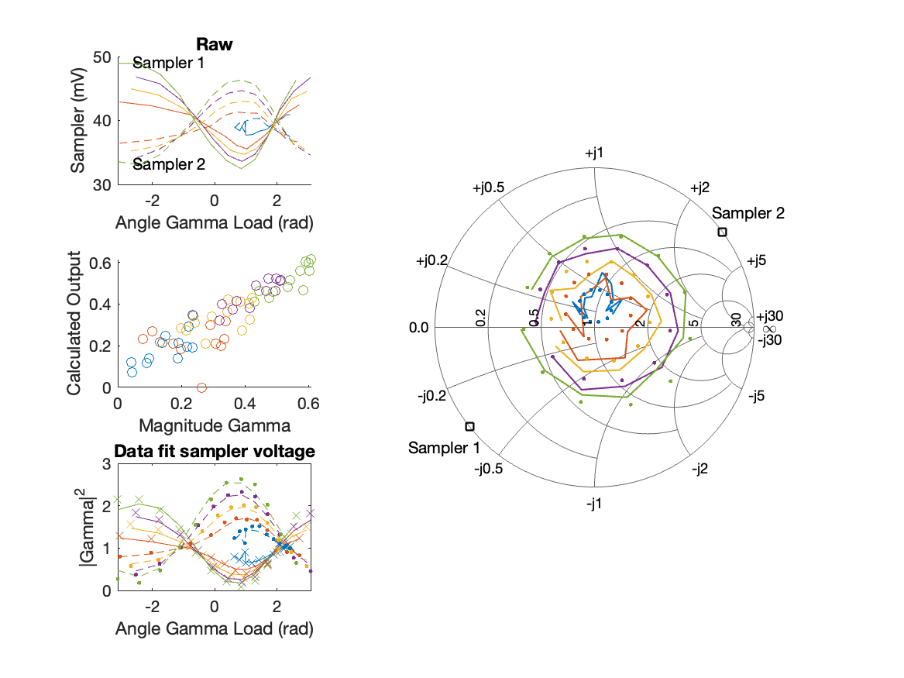
Sampler Performance x^3 Frequency 11.20 GHz, Power 14 dBm
Sampler Av
Sampler 1: 3.015410e+01
Sampler 2: 92.027
Sampler Av3
Sampler 1: 18.708
Sampler 2: 4.248
Sampler Offset (rather than -1)
-5.1208
Goodness Of fit
0.09142

Slide 49
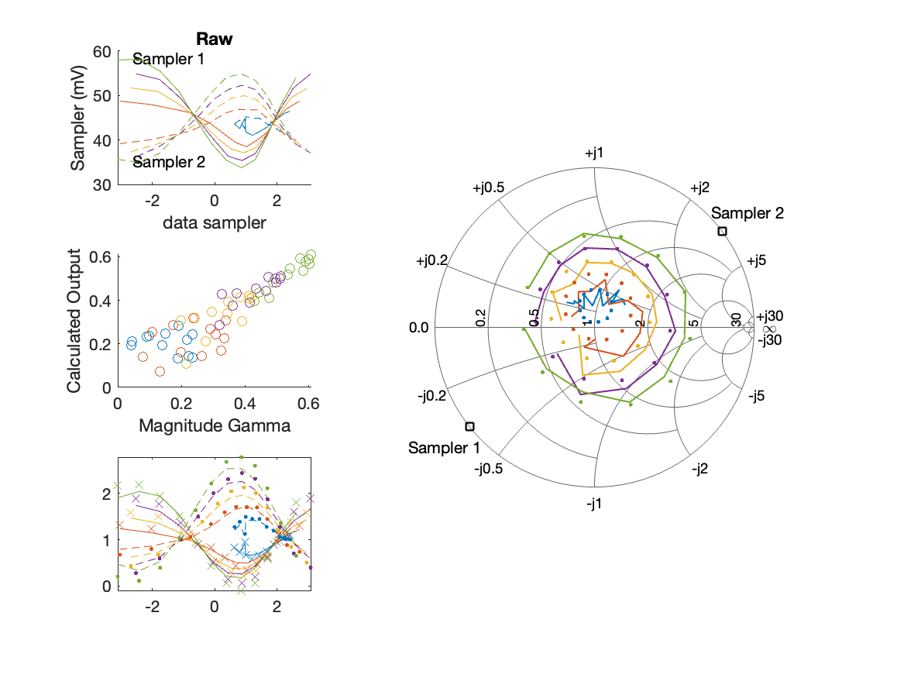
Sampler Performance Frequency 11.20 GHz, Power 16 dBm
Sampler Av
Sampler 1: 46.869
Sampler 2: 67.129
Sampler Offset (rather than -1)
-4.9193
Goodness Of fit
0.070607

Slide 50
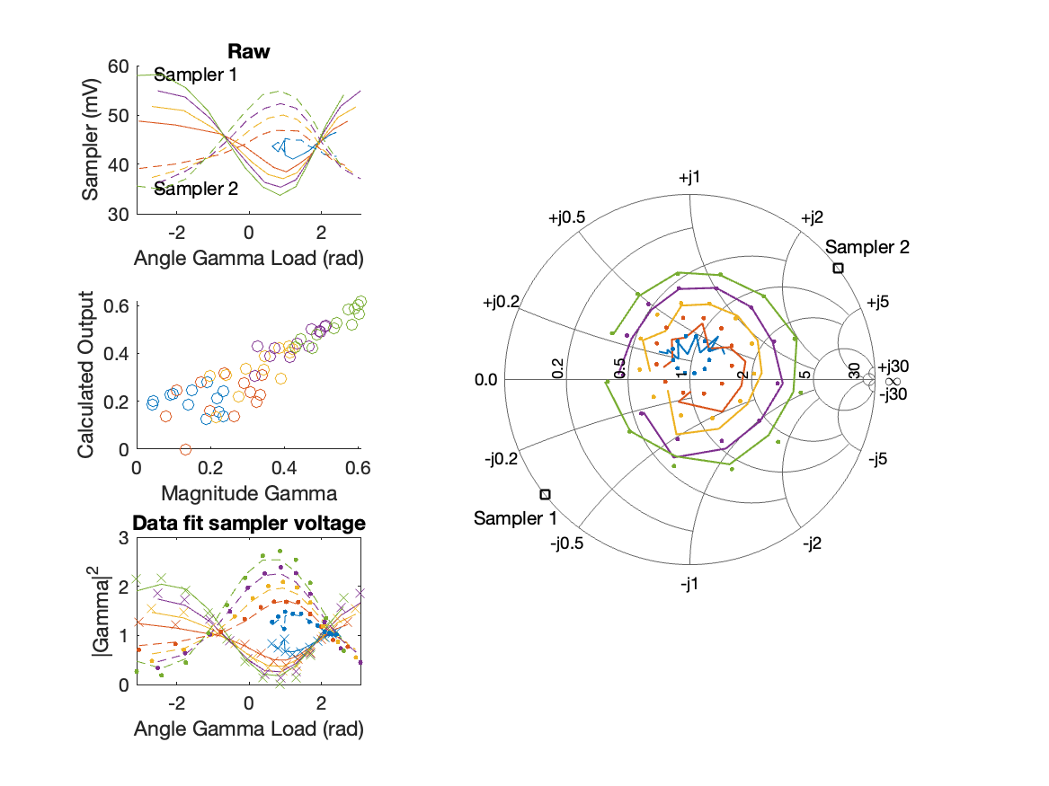
Sampler Performance x^3 Frequency 11.20 GHz, Power 16 dBm
Sampler Av
Sampler 1: 3.500226e+01
Sampler 2: 60.666
Sampler Av3
Sampler 1: 11.286
Sampler 2: 7.924
Sampler Offset (rather than -1)
-4.2829
Goodness Of fit
0.066494

Slide 51
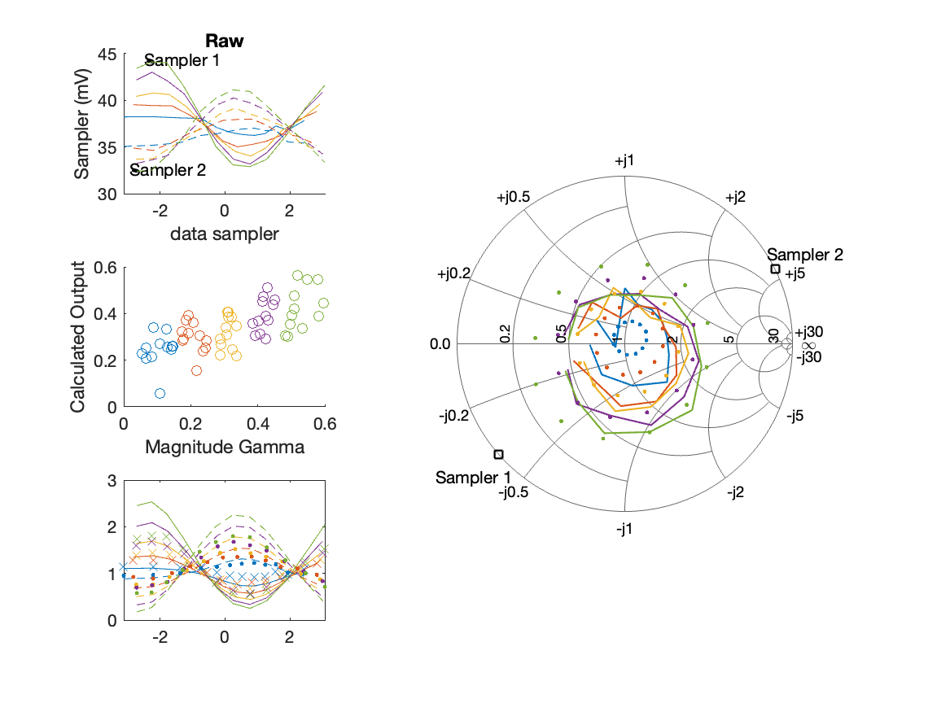
Sampler Performance Frequency 11.30 GHz, Power 12 dBm
Sampler Av
Sampler 1: 56.330
Sampler 2: 69.997
Sampler Offset (rather than -1)
-4.5649
Goodness Of fit
0.31228

Slide 52
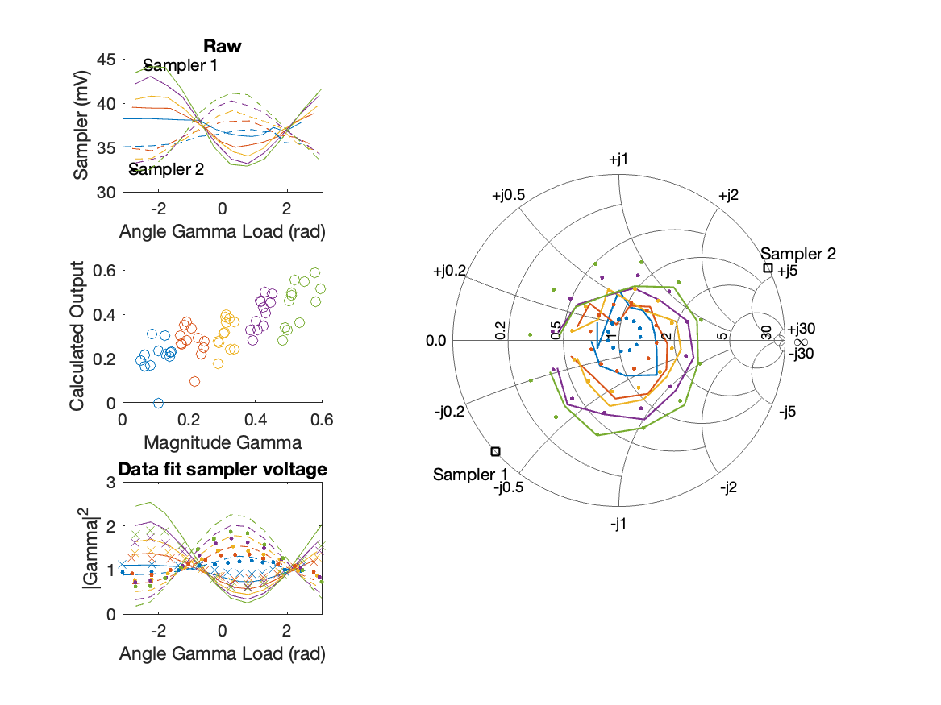
Sampler Performance x^3 Frequency 11.30 GHz, Power 12 dBm
Sampler Av
Sampler 1: 7.900077e-06
Sampler 2: 0.002
Sampler Av3
Sampler 1: 23.476
Sampler 2: 25.951
Sampler Offset (rather than -1)
-1.4492
Goodness Of fit
0.21106

Slide 53
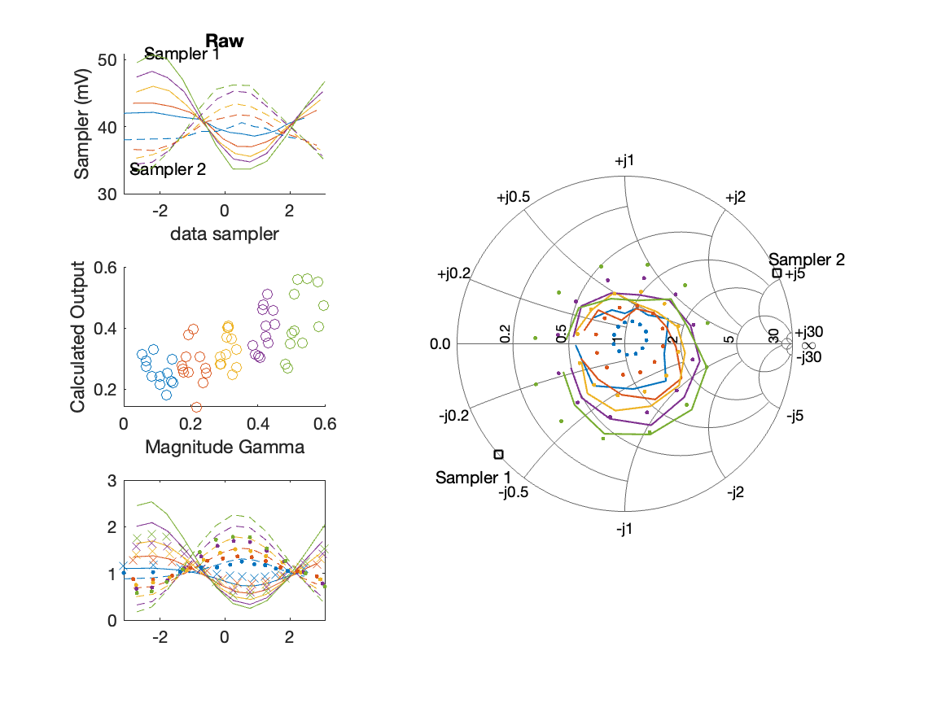
Sampler Performance Frequency 11.30 GHz, Power 14 dBm
Sampler Av
Sampler 1: 38.404
Sampler 2: 46.994
Sampler Offset (rather than -1)
-3.3146
Goodness Of fit
0.30083

Slide 54
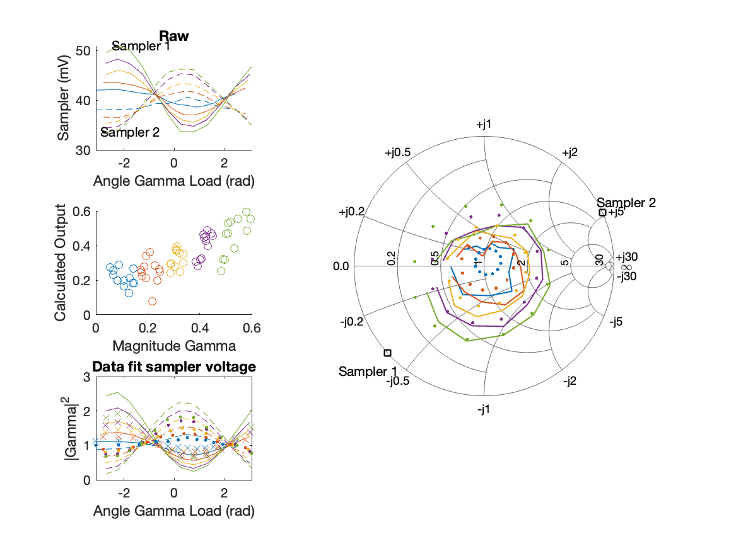
Sampler Performance x^3 Frequency 11.30 GHz, Power 14 dBm
Sampler Av
Sampler 1: 1.451255e-10
Sampler 2: 0.000
Sampler Av3
Sampler 1: 19.134
Sampler 2: 21.066
Sampler Offset (rather than -1)
-0.9685
Goodness Of fit
0.18546

Slide 55
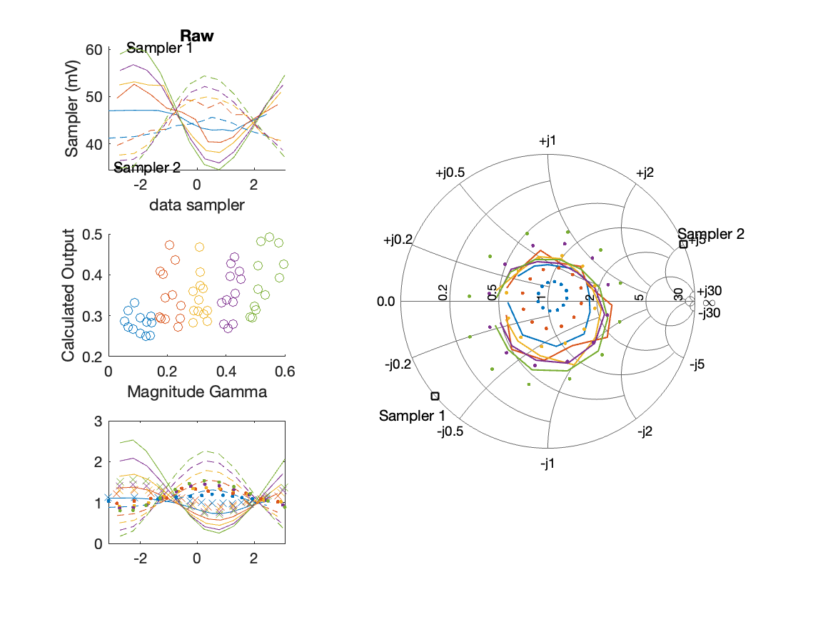
Sampler Performance Frequency 11.30 GHz, Power 16 dBm
Sampler Av
Sampler 1: 16.457
Sampler 2: 18.659
Sampler Offset (rather than -1)
-1.4678
Goodness Of fit
0.45431

Slide 56
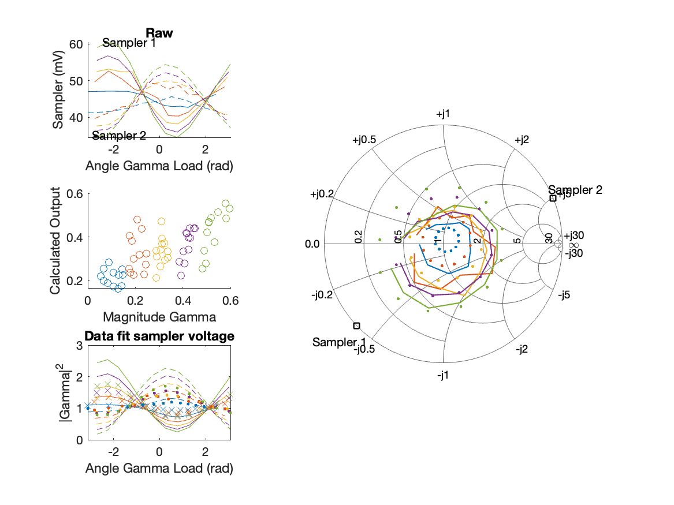
Sampler Performance x^3 Frequency 11.30 GHz, Power 16 dBm
Sampler Av
Sampler 1: 2.220461e-14
Sampler 2: 0.000
Sampler Av3
Sampler 1: 14.352
Sampler 2: 15.687
Sampler Offset (rather than -1)
-0.53637
Goodness Of fit
0.29316

Slide 57
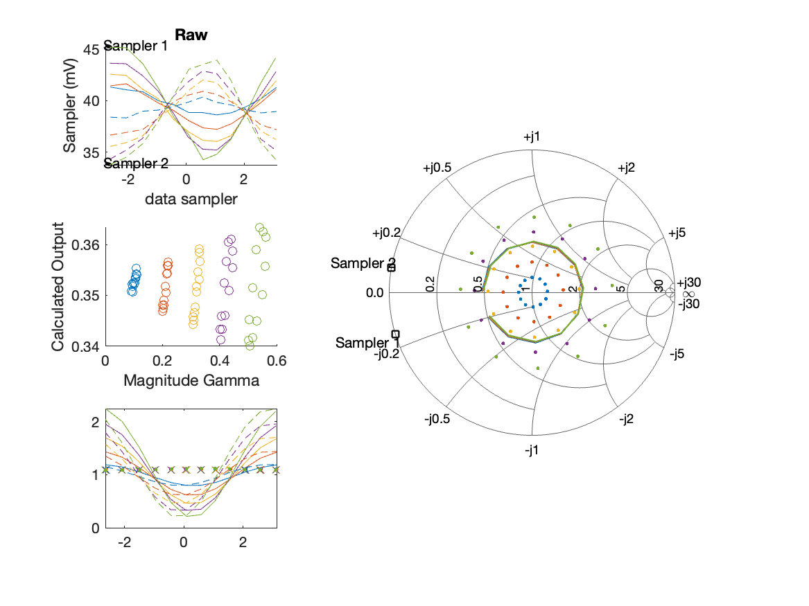
Sampler Performance Frequency 11.40 GHz, Power 12 dBm
Sampler Av
Sampler 1: 0.000
Sampler 2: 1.632
Sampler Offset (rather than -1)
0.060412
Goodness Of fit
0.58132

Slide 58

Sampler Performance x^3 Frequency 11.40 GHz, Power 12 dBm
Sampler Av
Sampler 1: 2.220450e-14
Sampler 2: 0.000
Sampler Av3
Sampler 1: 18.529
Sampler 2: 19.509
Sampler Offset (rather than -1)
-0.71391
Goodness Of fit
0.53784

Slide 59

Sampler Performance Frequency 11.40 GHz, Power 14 dBm
Sampler Av
Sampler 1: 70.652
Sampler 2: 75.196
Sampler Offset (rather than -1)
-5.9108
Goodness Of fit
0.21452

Slide 60

Sampler Performance x^3 Frequency 11.40 GHz, Power 14 dBm
Sampler Av
Sampler 1: 4.342409e+01
Sampler 2: 0.001
Sampler Av3
Sampler 1: 14.269
Sampler 2: 23.040
Sampler Offset (rather than -1)
-2.7702
Goodness Of fit
0.1656

Slide 61

Sampler Performance Frequency 11.40 GHz, Power 16 dBm
Sampler Av
Sampler 1: 55.618
Sampler 2: 57.740
Sampler Offset (rather than -1)
-5.0527
Goodness Of fit
0.1028

Slide 62

Sampler Performance x^3 Frequency 11.40 GHz, Power 16 dBm
Sampler Av
Sampler 1: 5.356167e+01
Sampler 2: 11.117
Sampler Av3
Sampler 1: -9.086
Sampler 2: 18.419
Sampler Offset (rather than -1)
-3.3757
Goodness Of fit
0.06408

